Slide 1
II. Python for Data Science

Slide 2
Recap
Intro to Data Science
SMART Goals
Dev Environment Setup

Slide 3
Agenda
Why Python?
Programming workflow and tools review
Python in the terminal
Break
Lab- iPython Notebook and Pandas

Slide 4
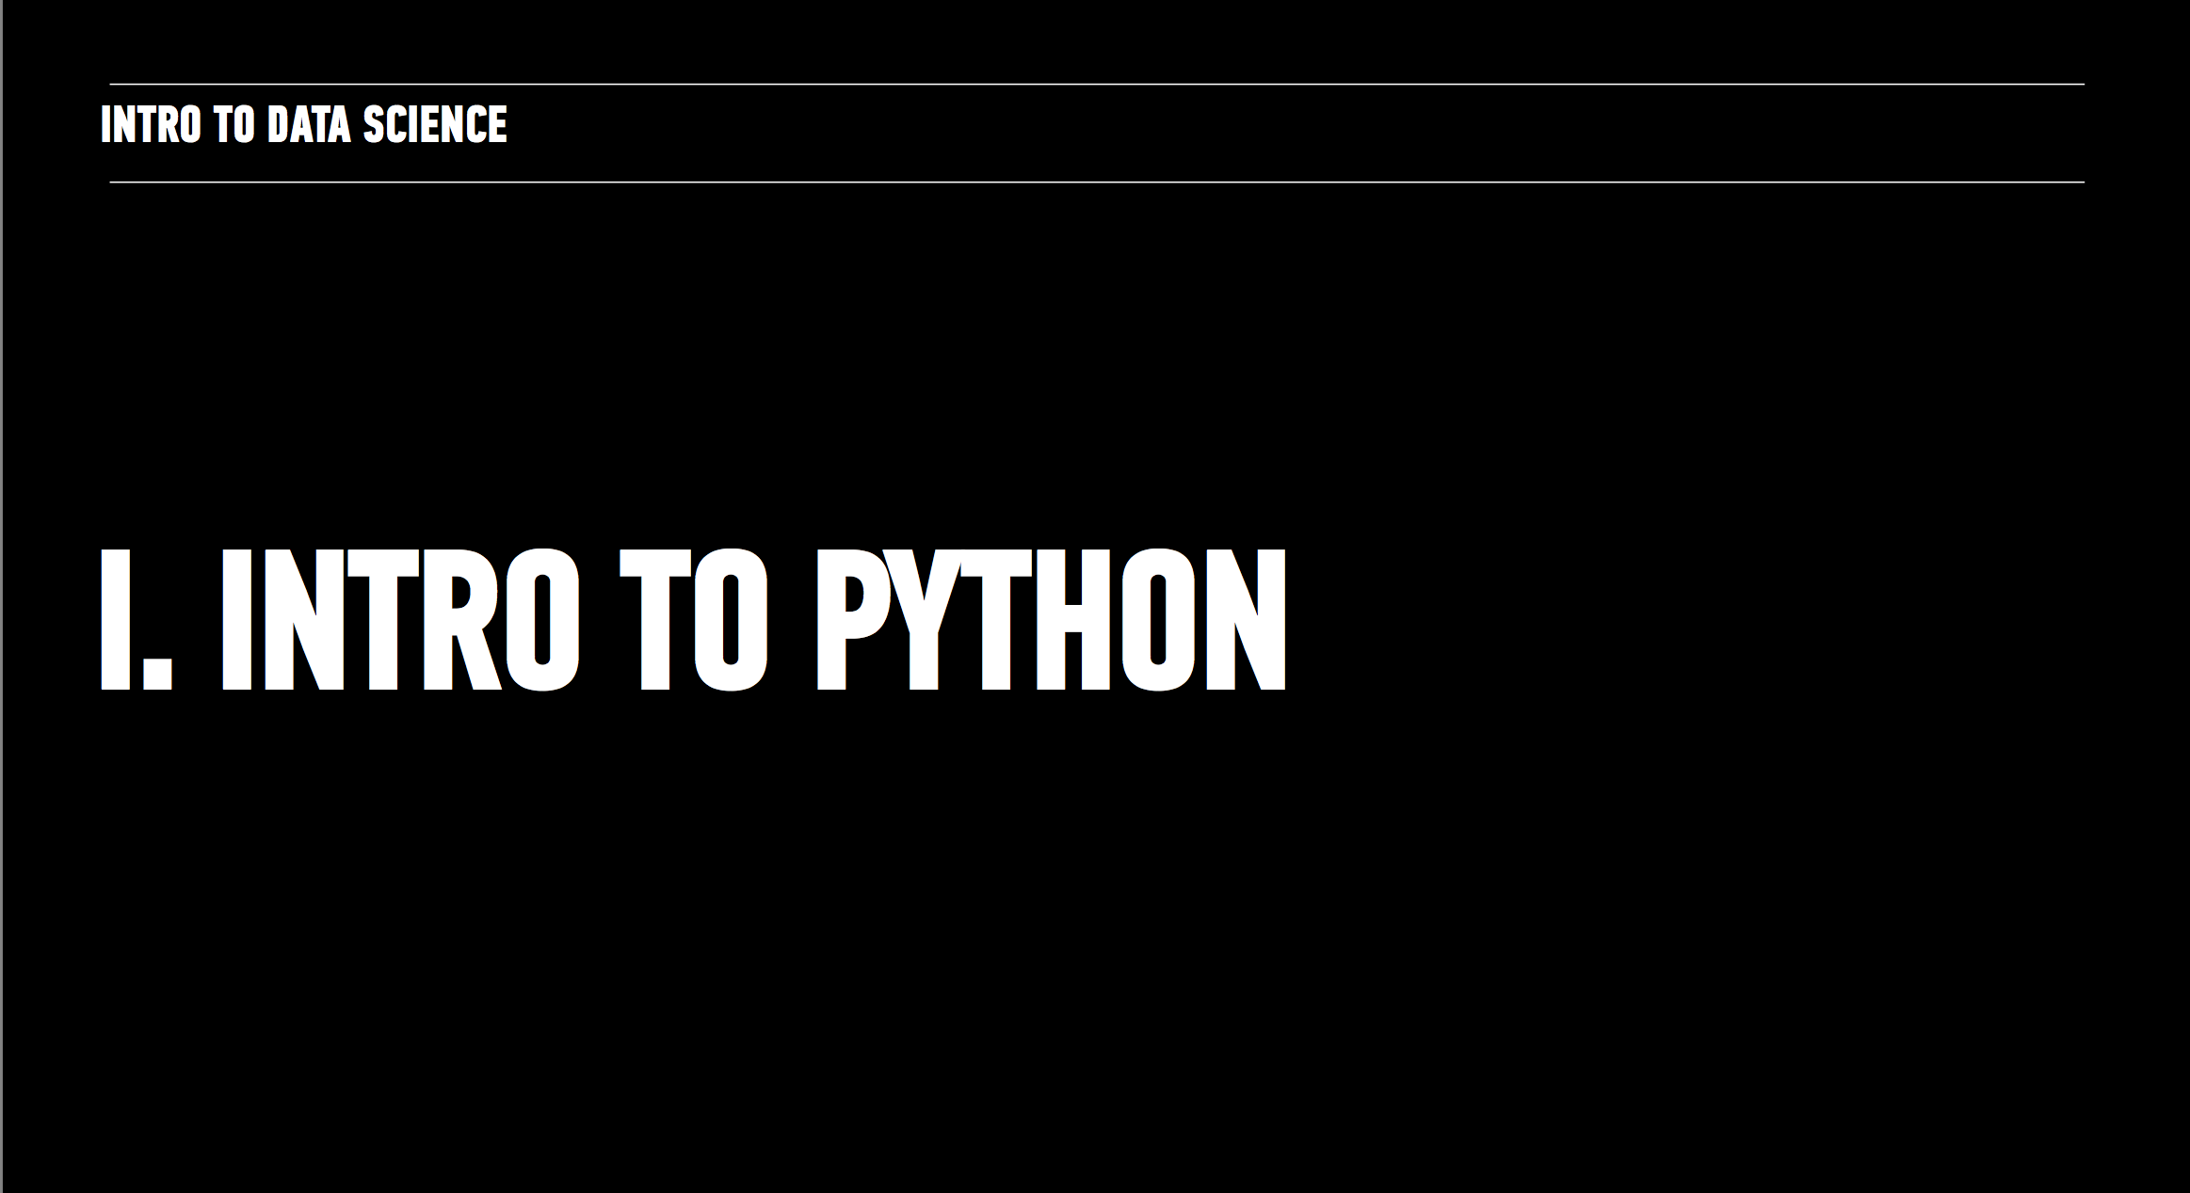

Slide 5
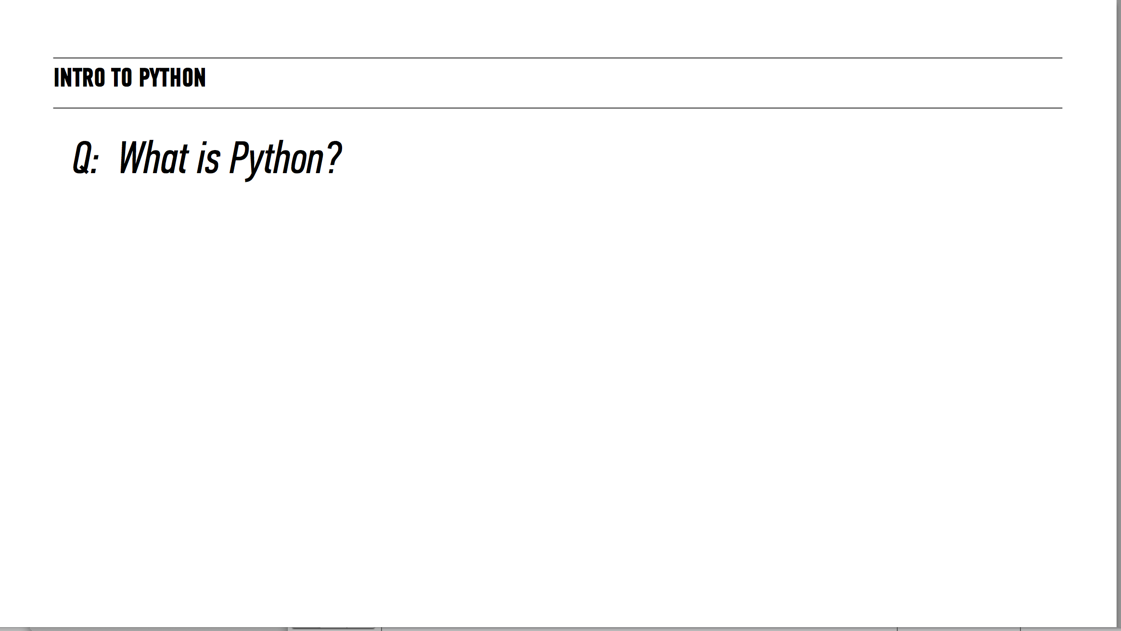

Slide 7
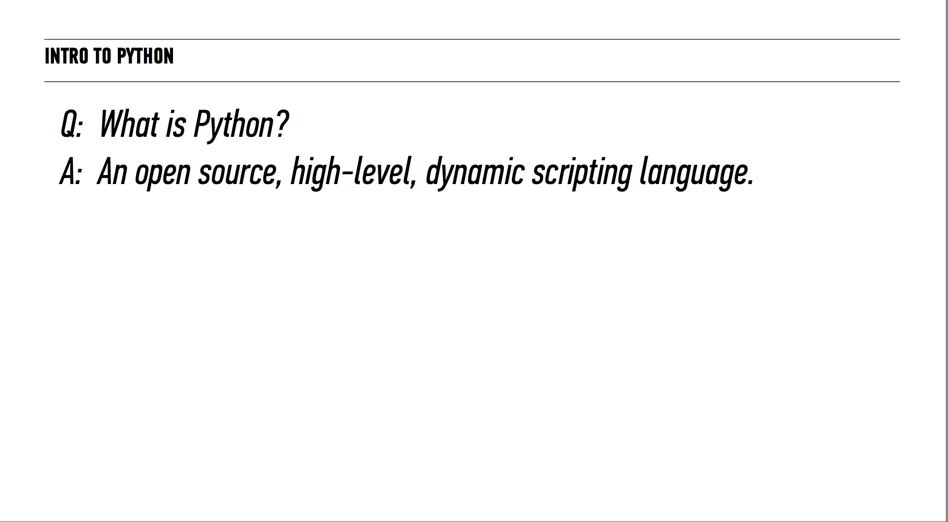

Slide 8
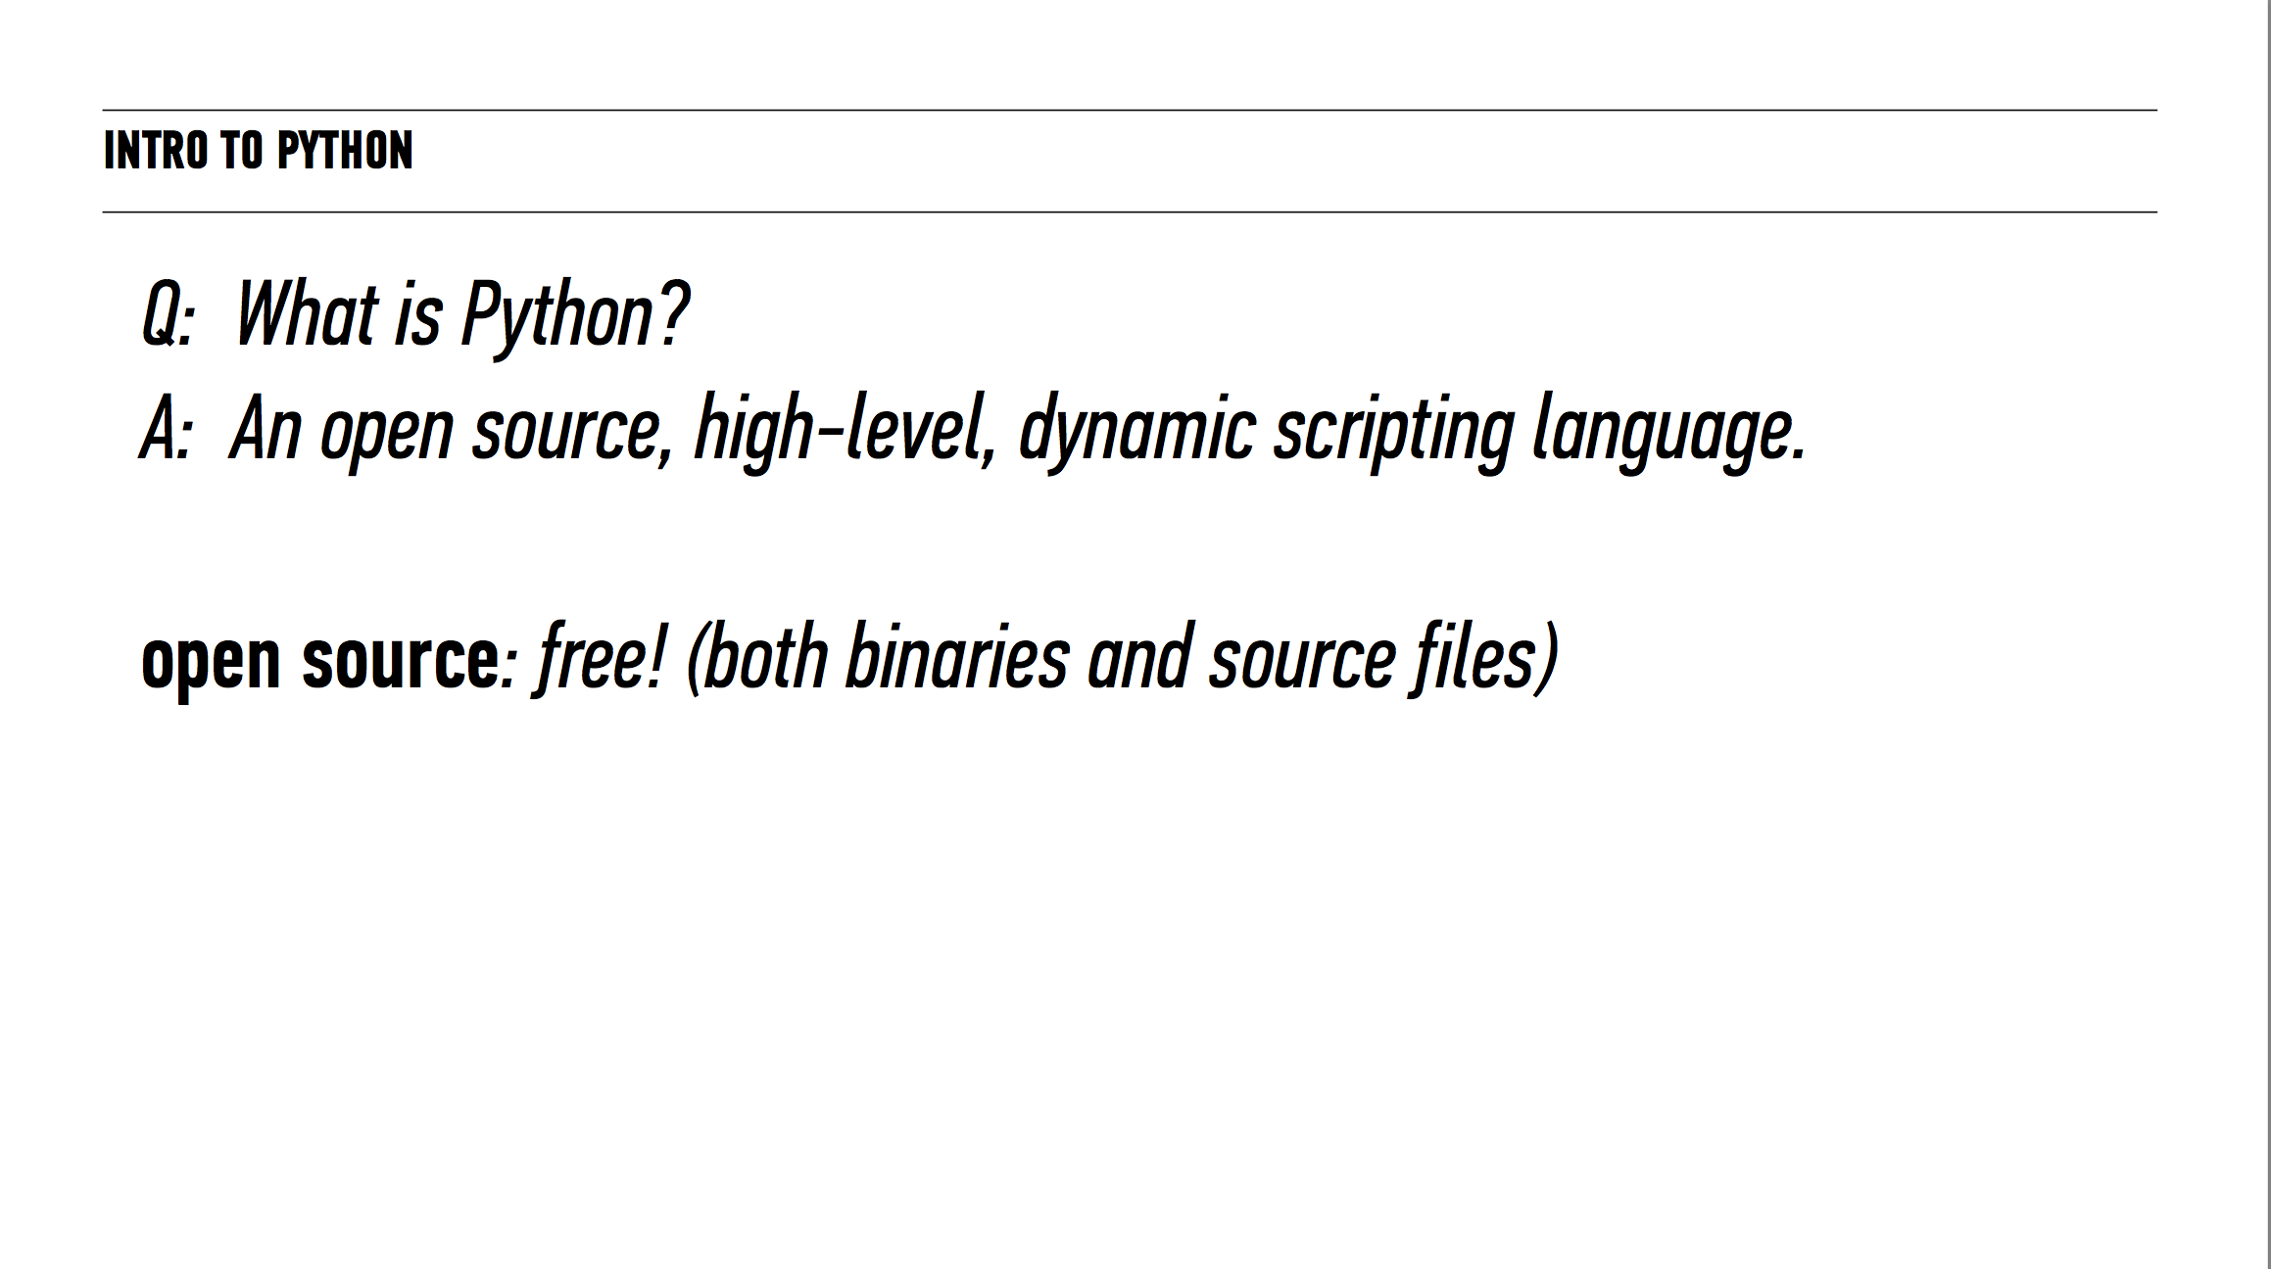

Slide 9
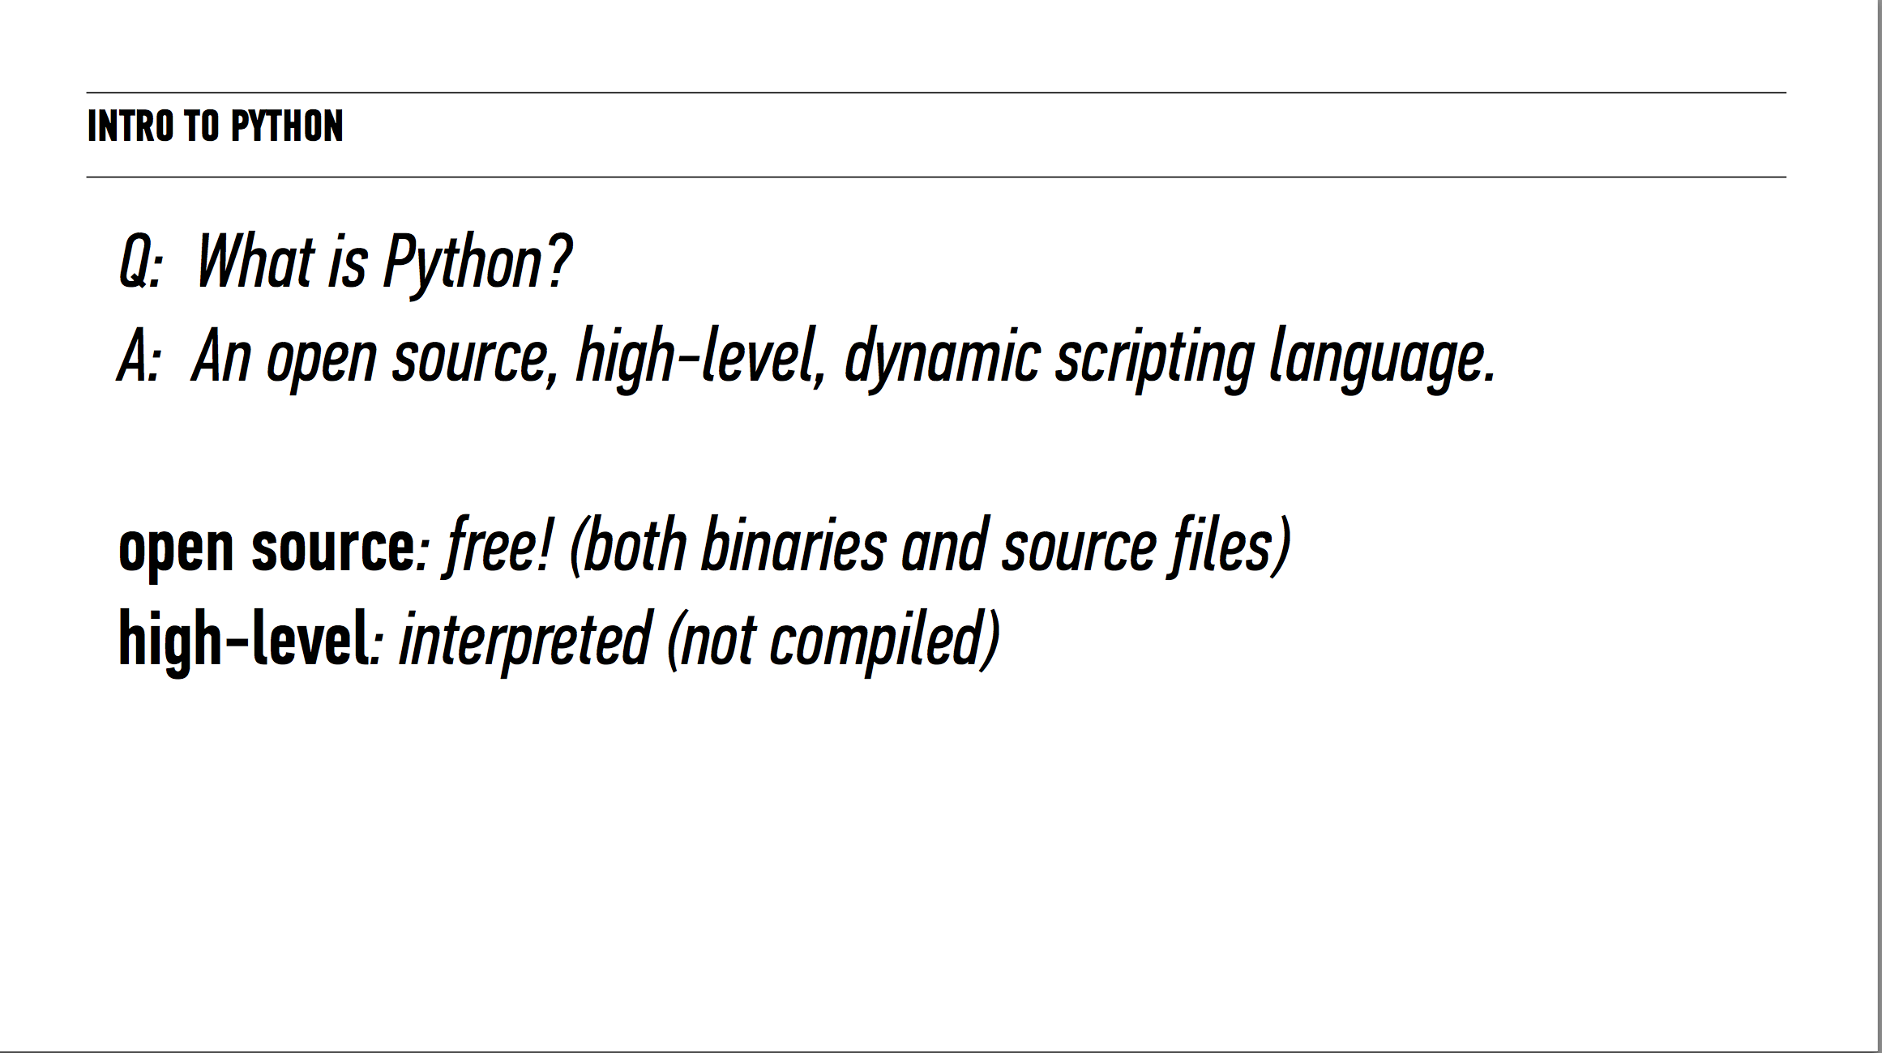

Slide 10
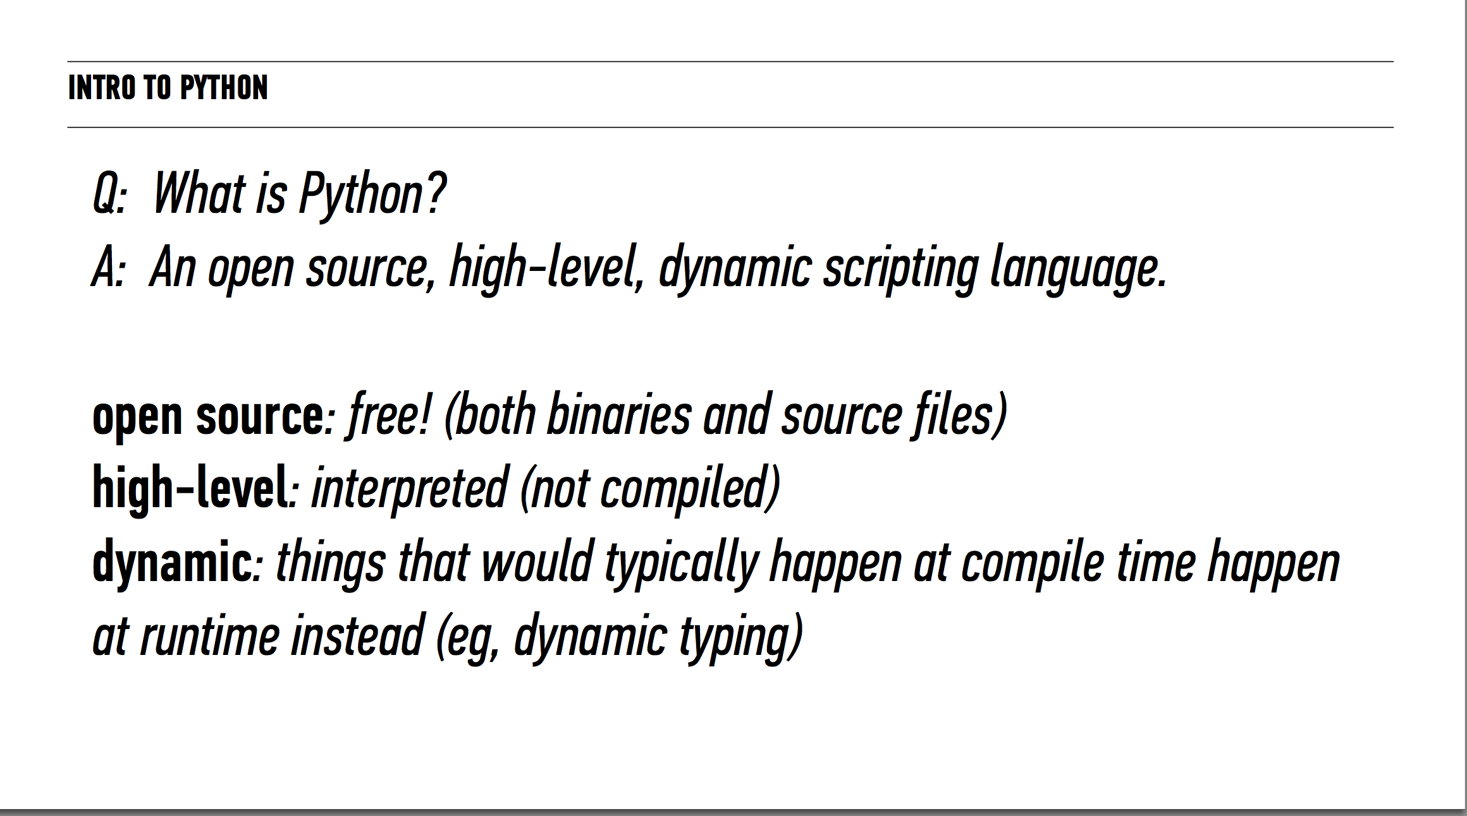

Slide 11
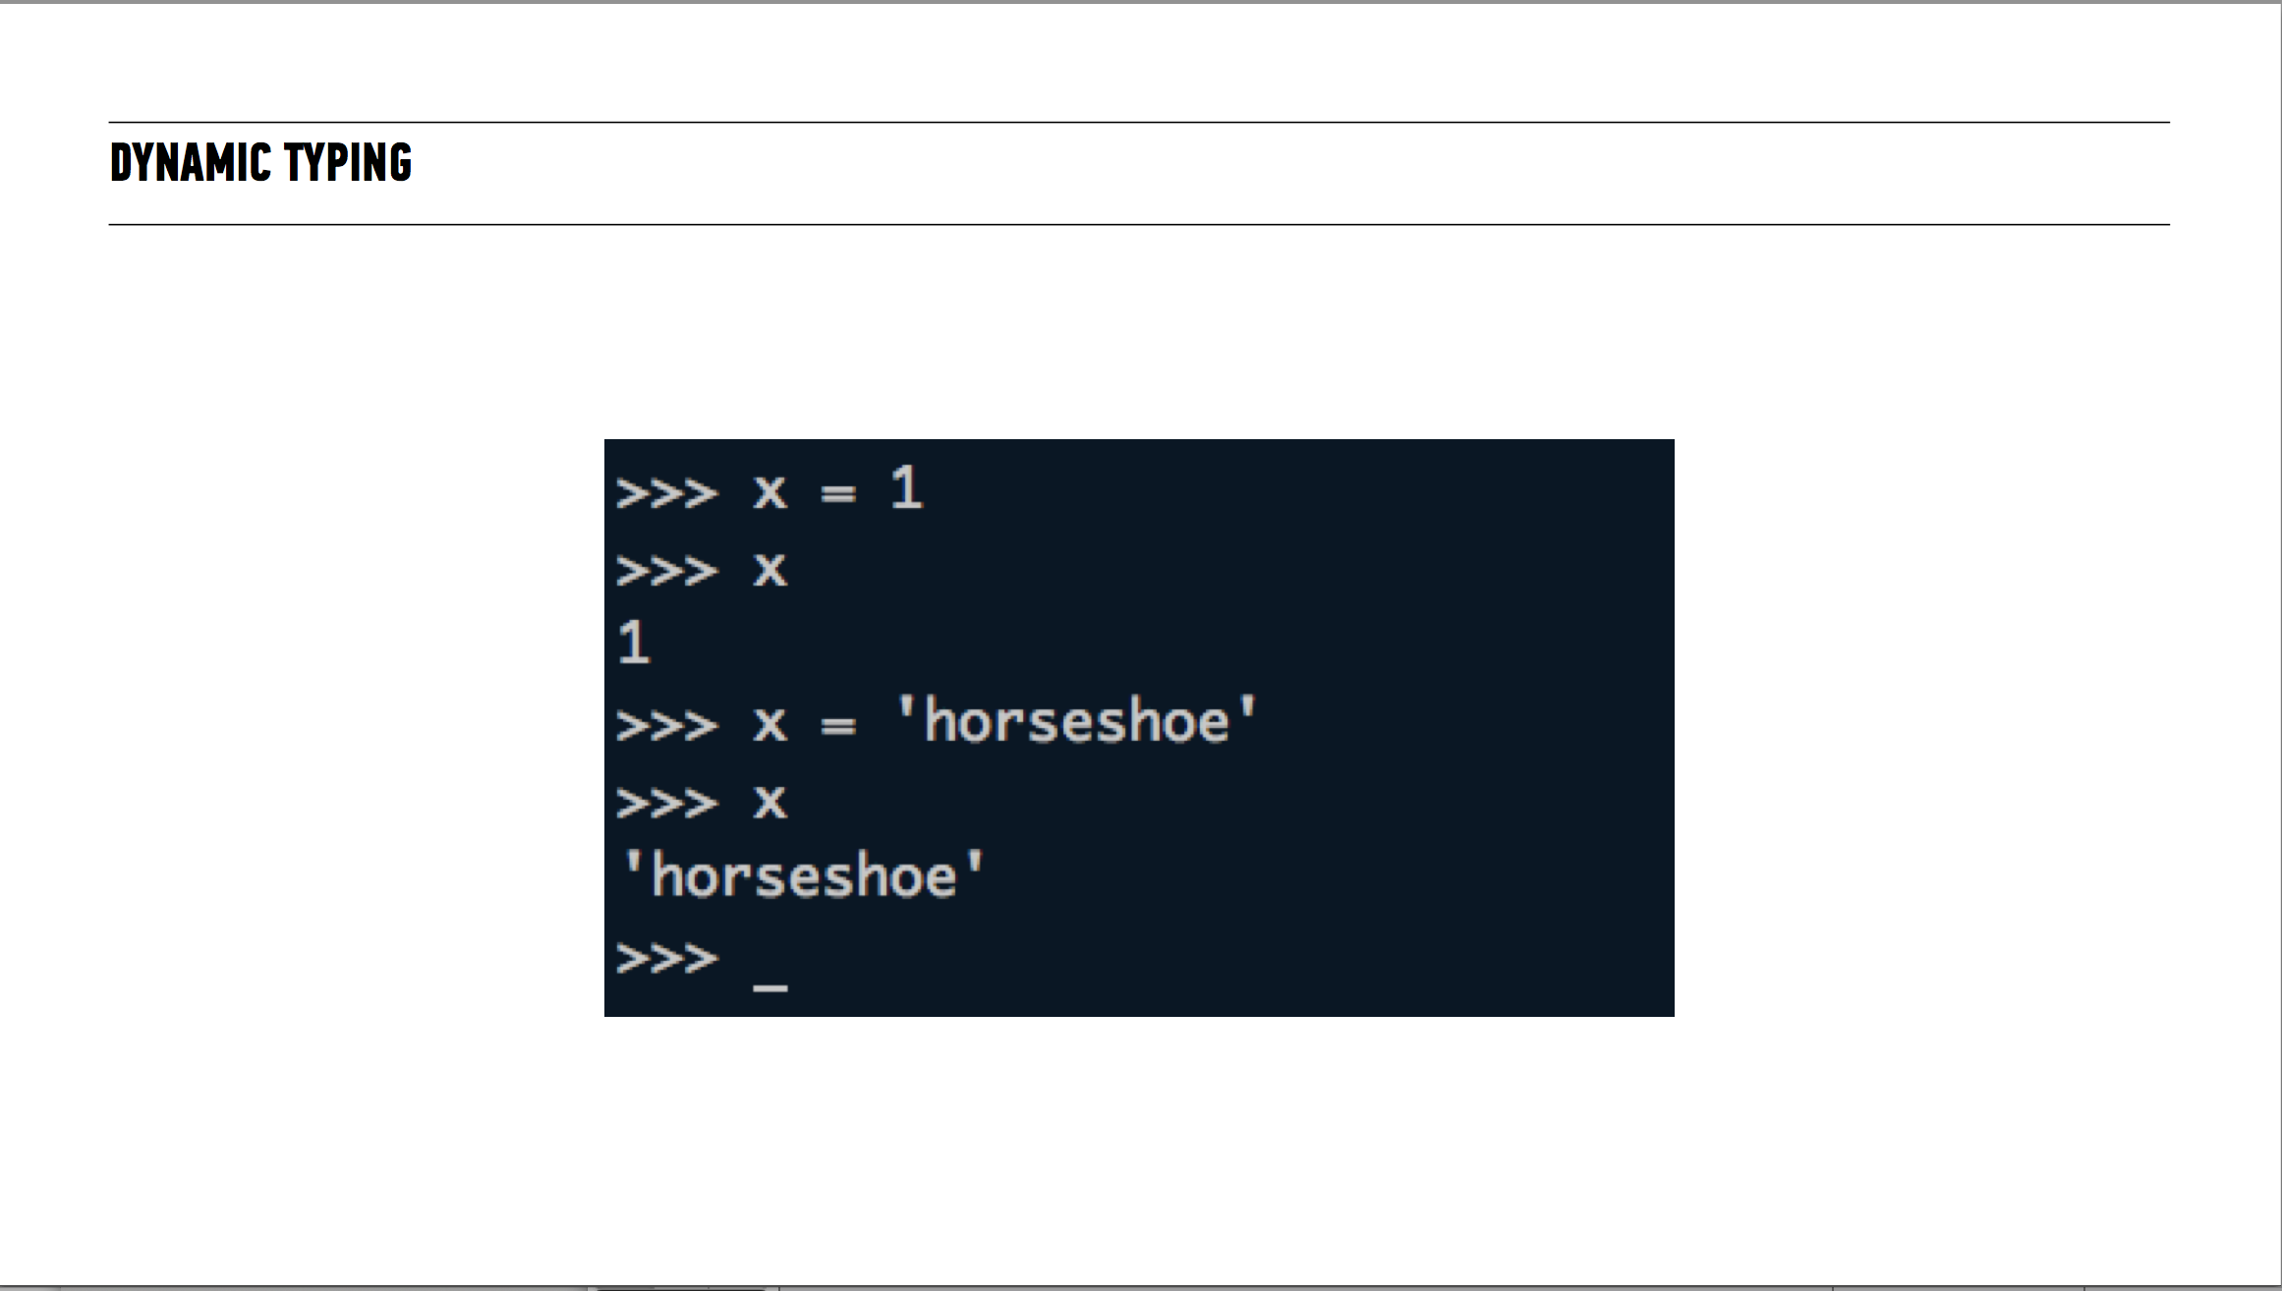

Slide 12
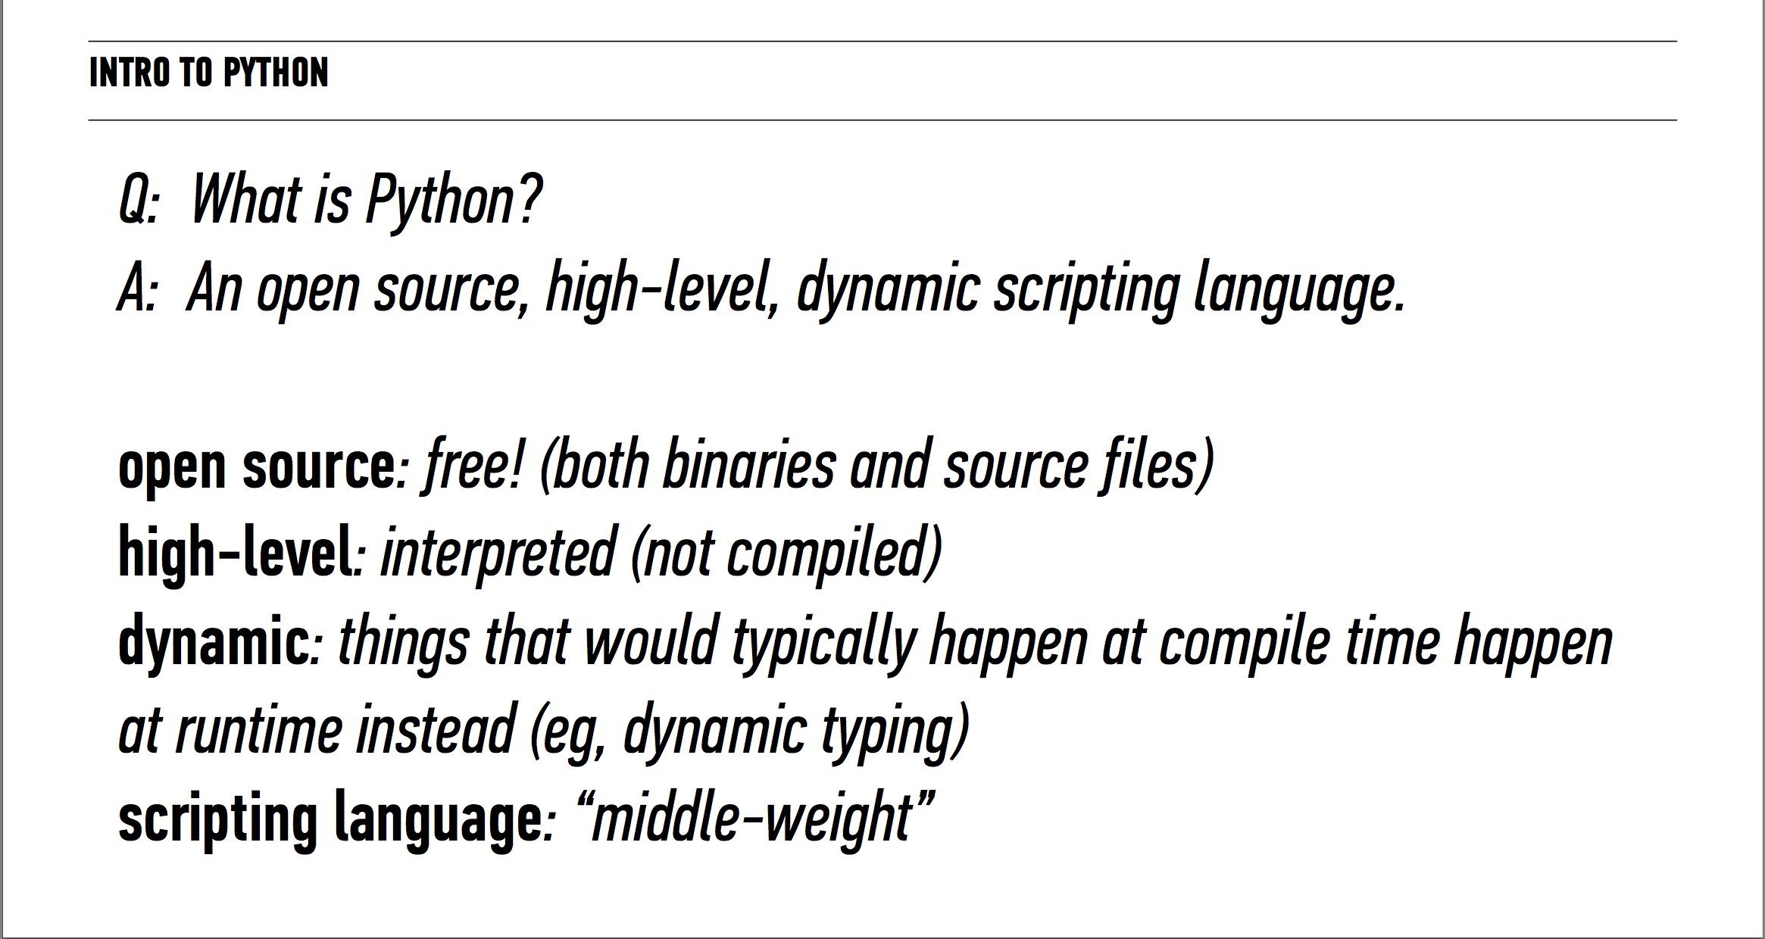

Slide 13
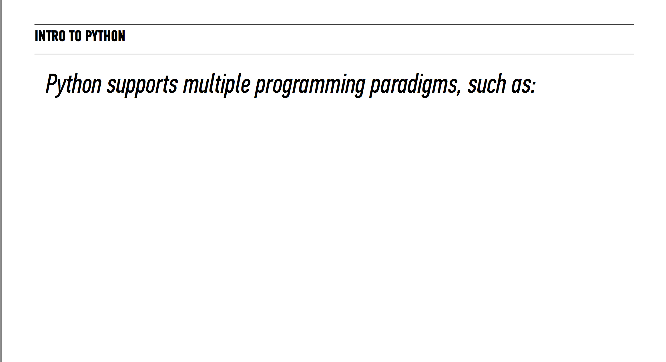

Slide 14
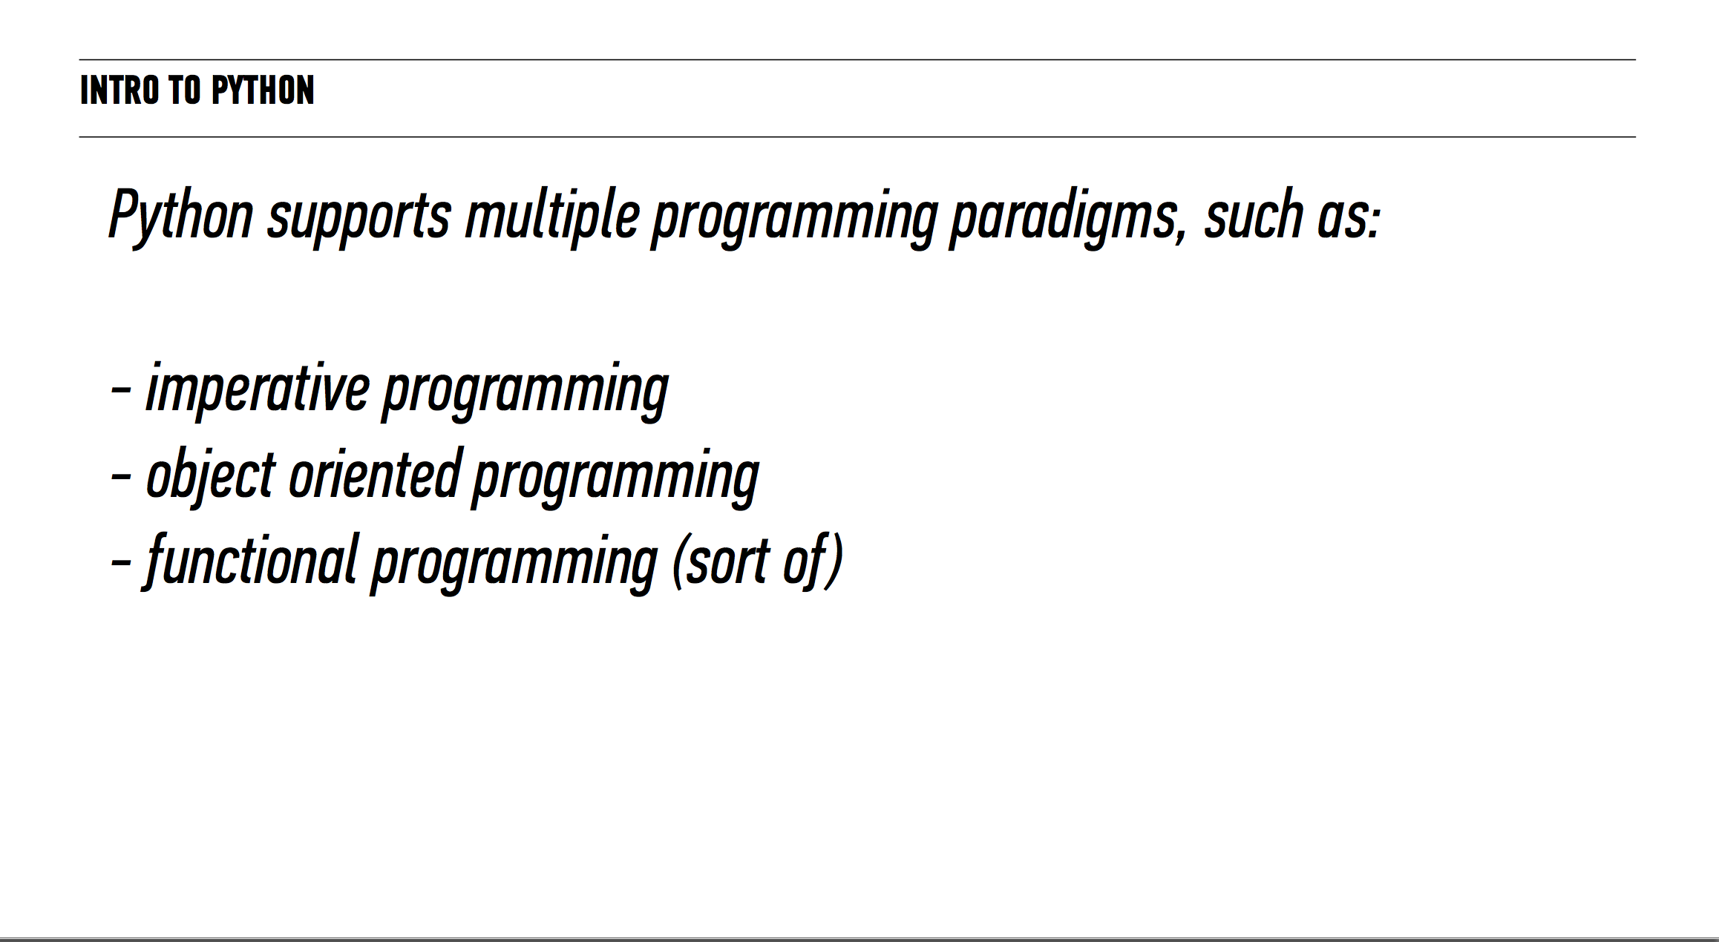

Slide 15
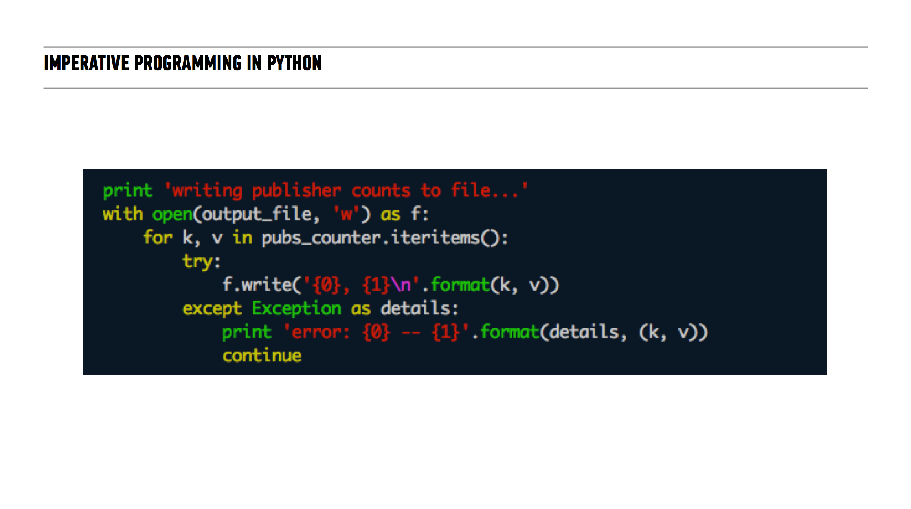

Slide 16
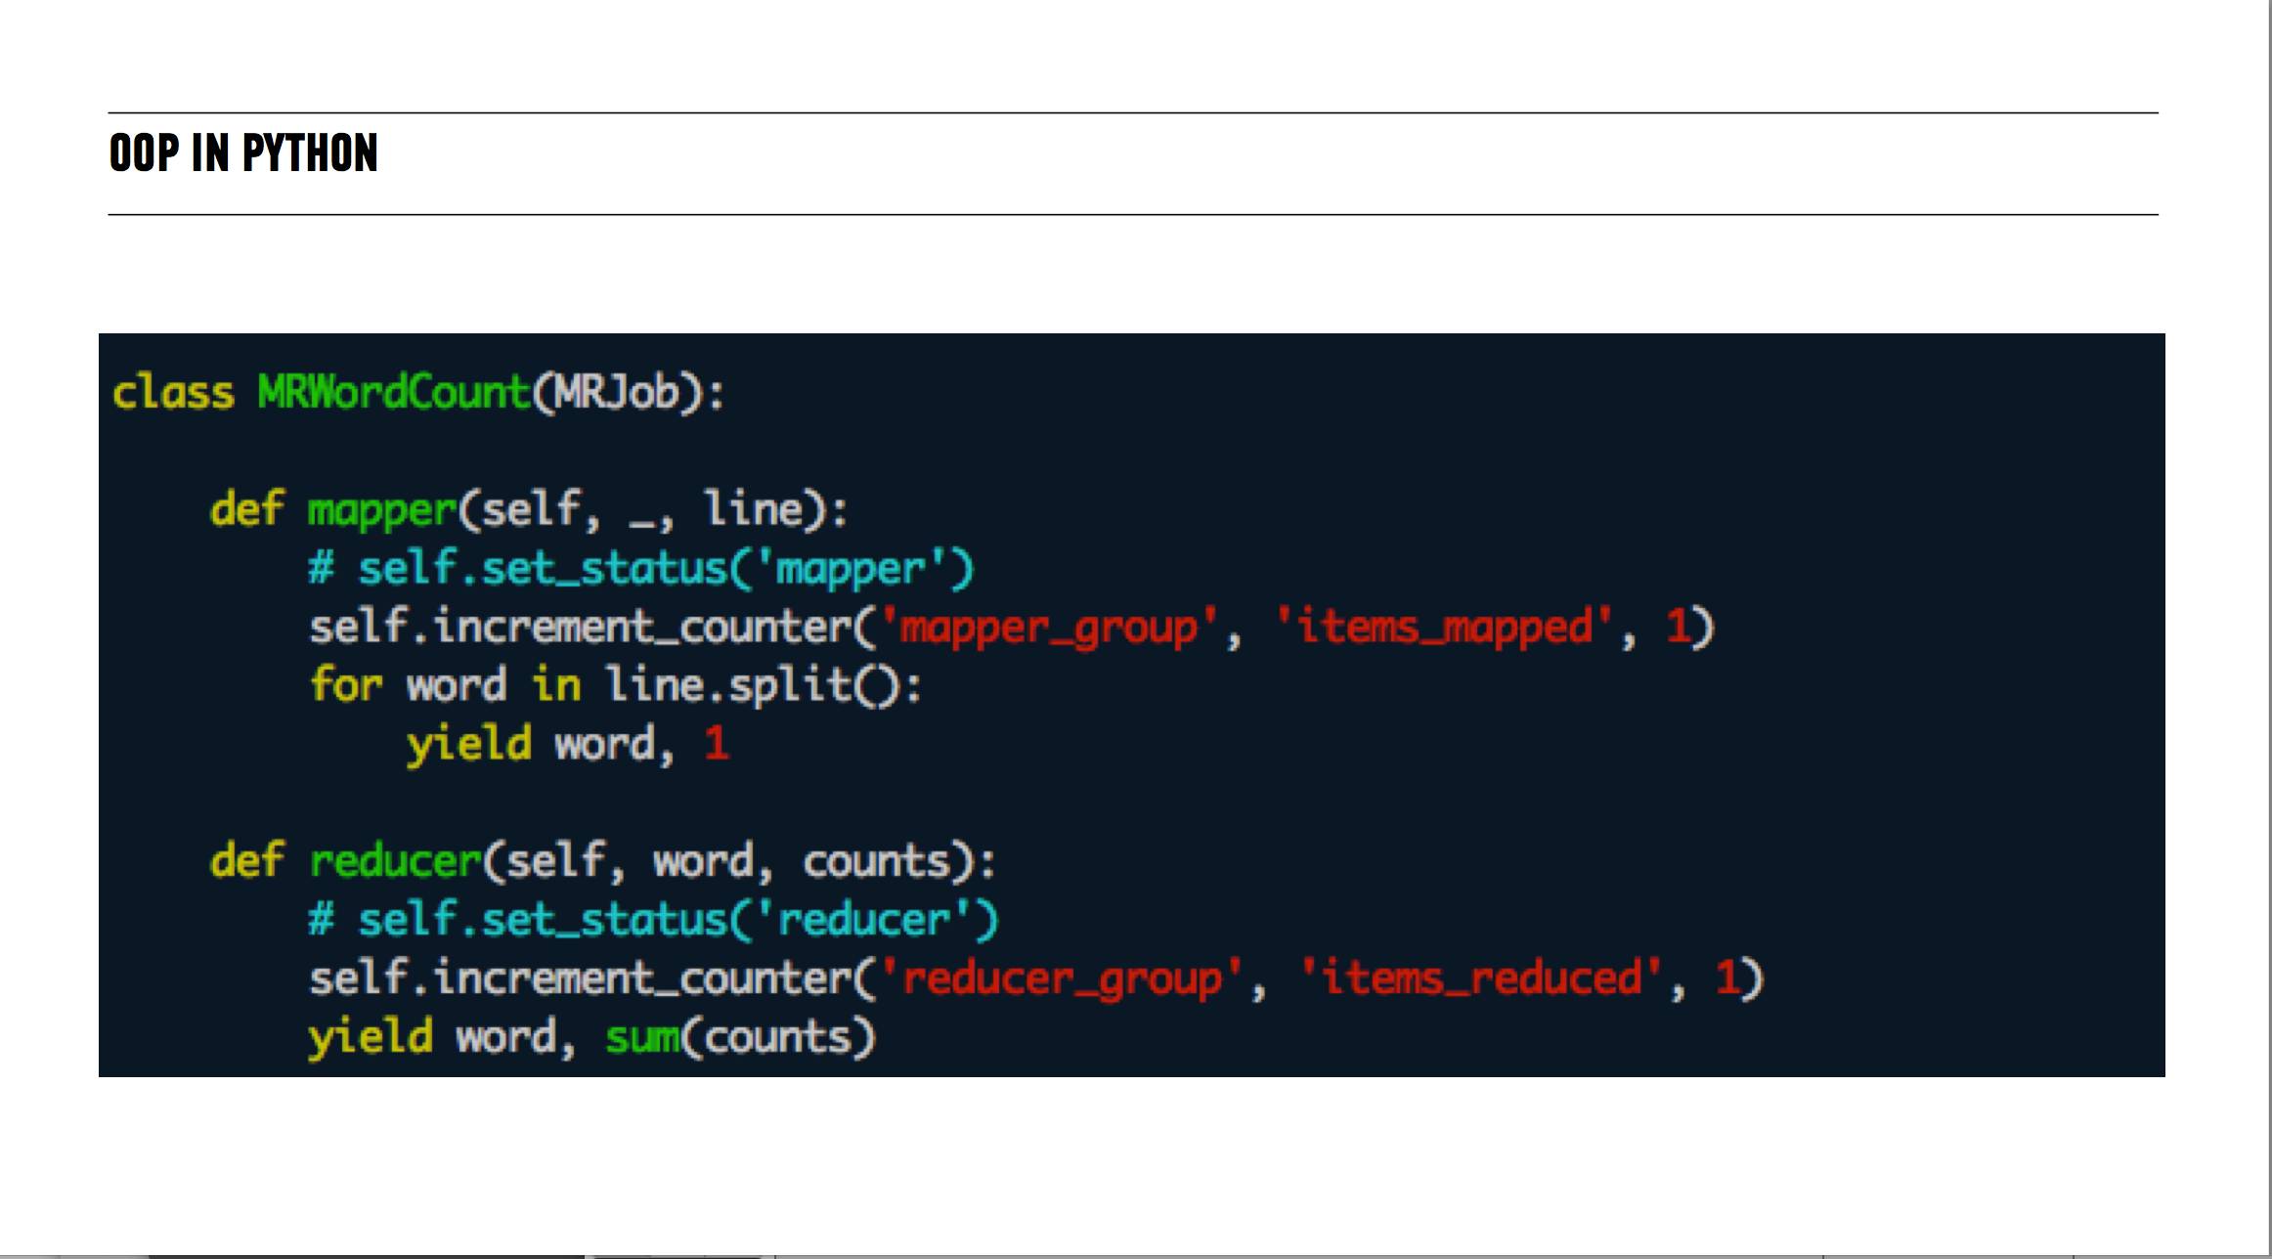

Slide 17
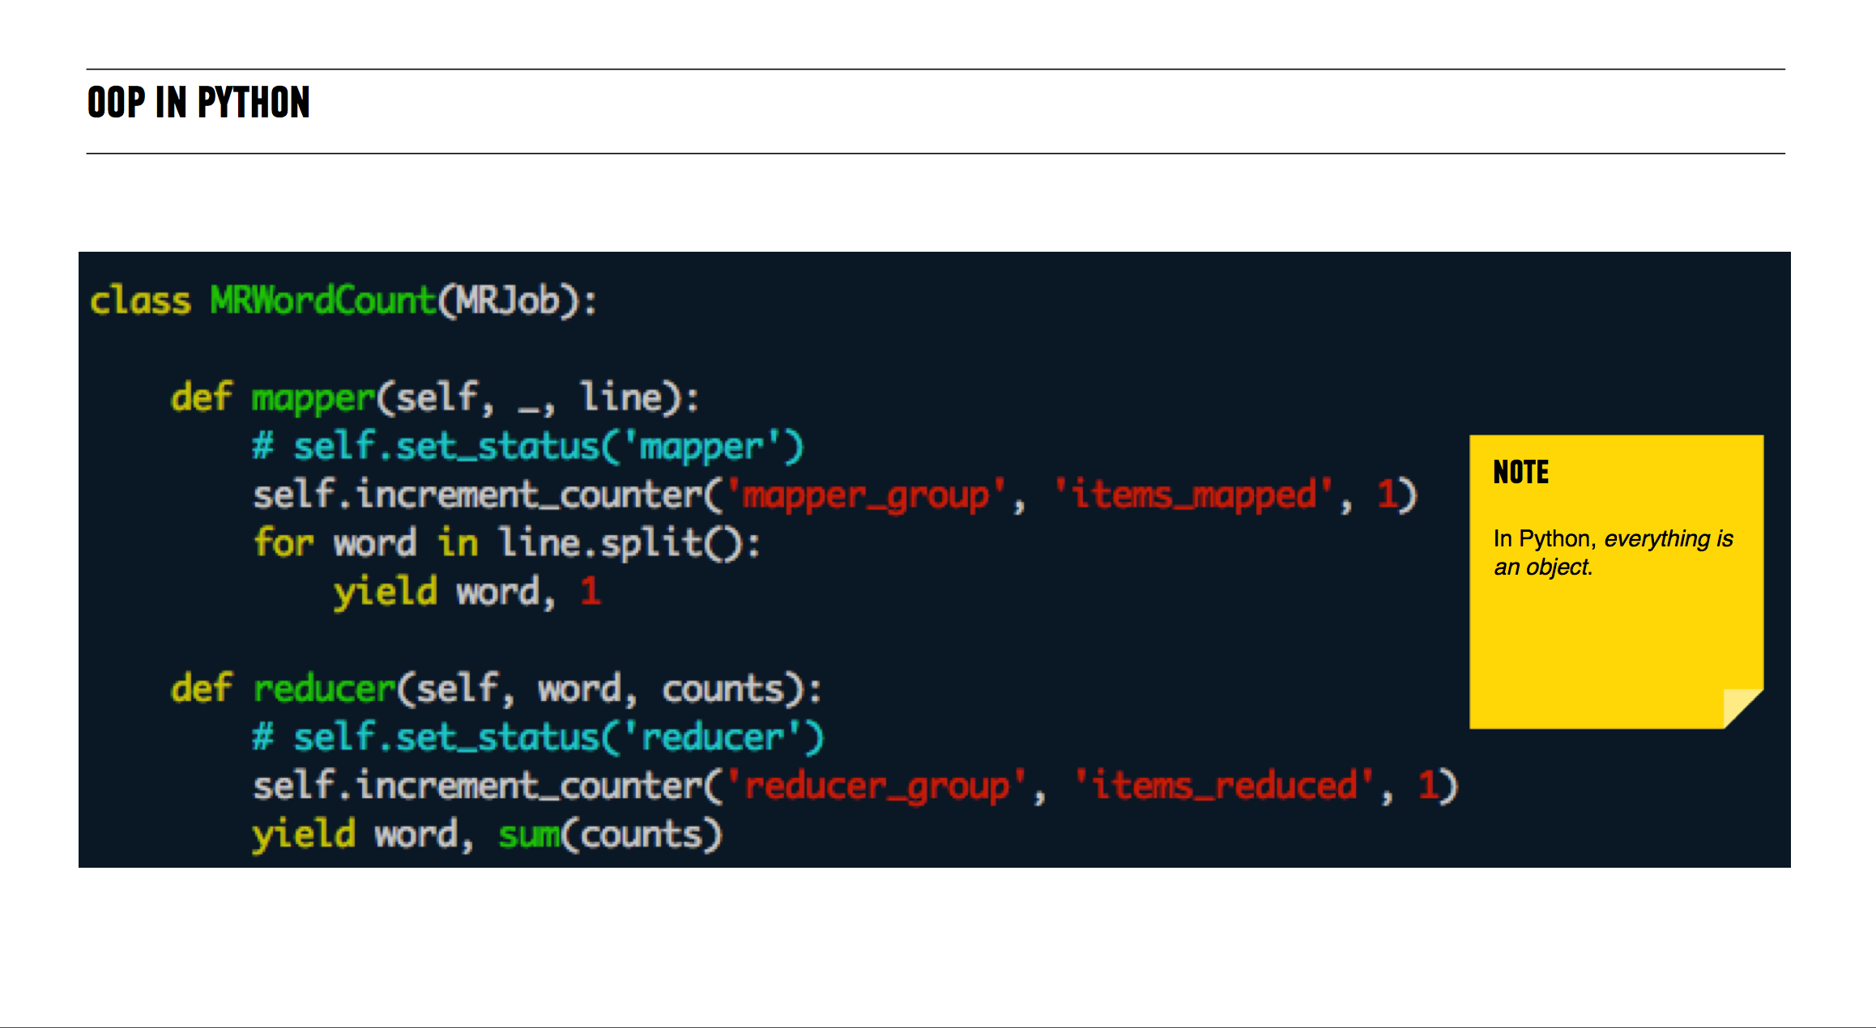

Slide 18
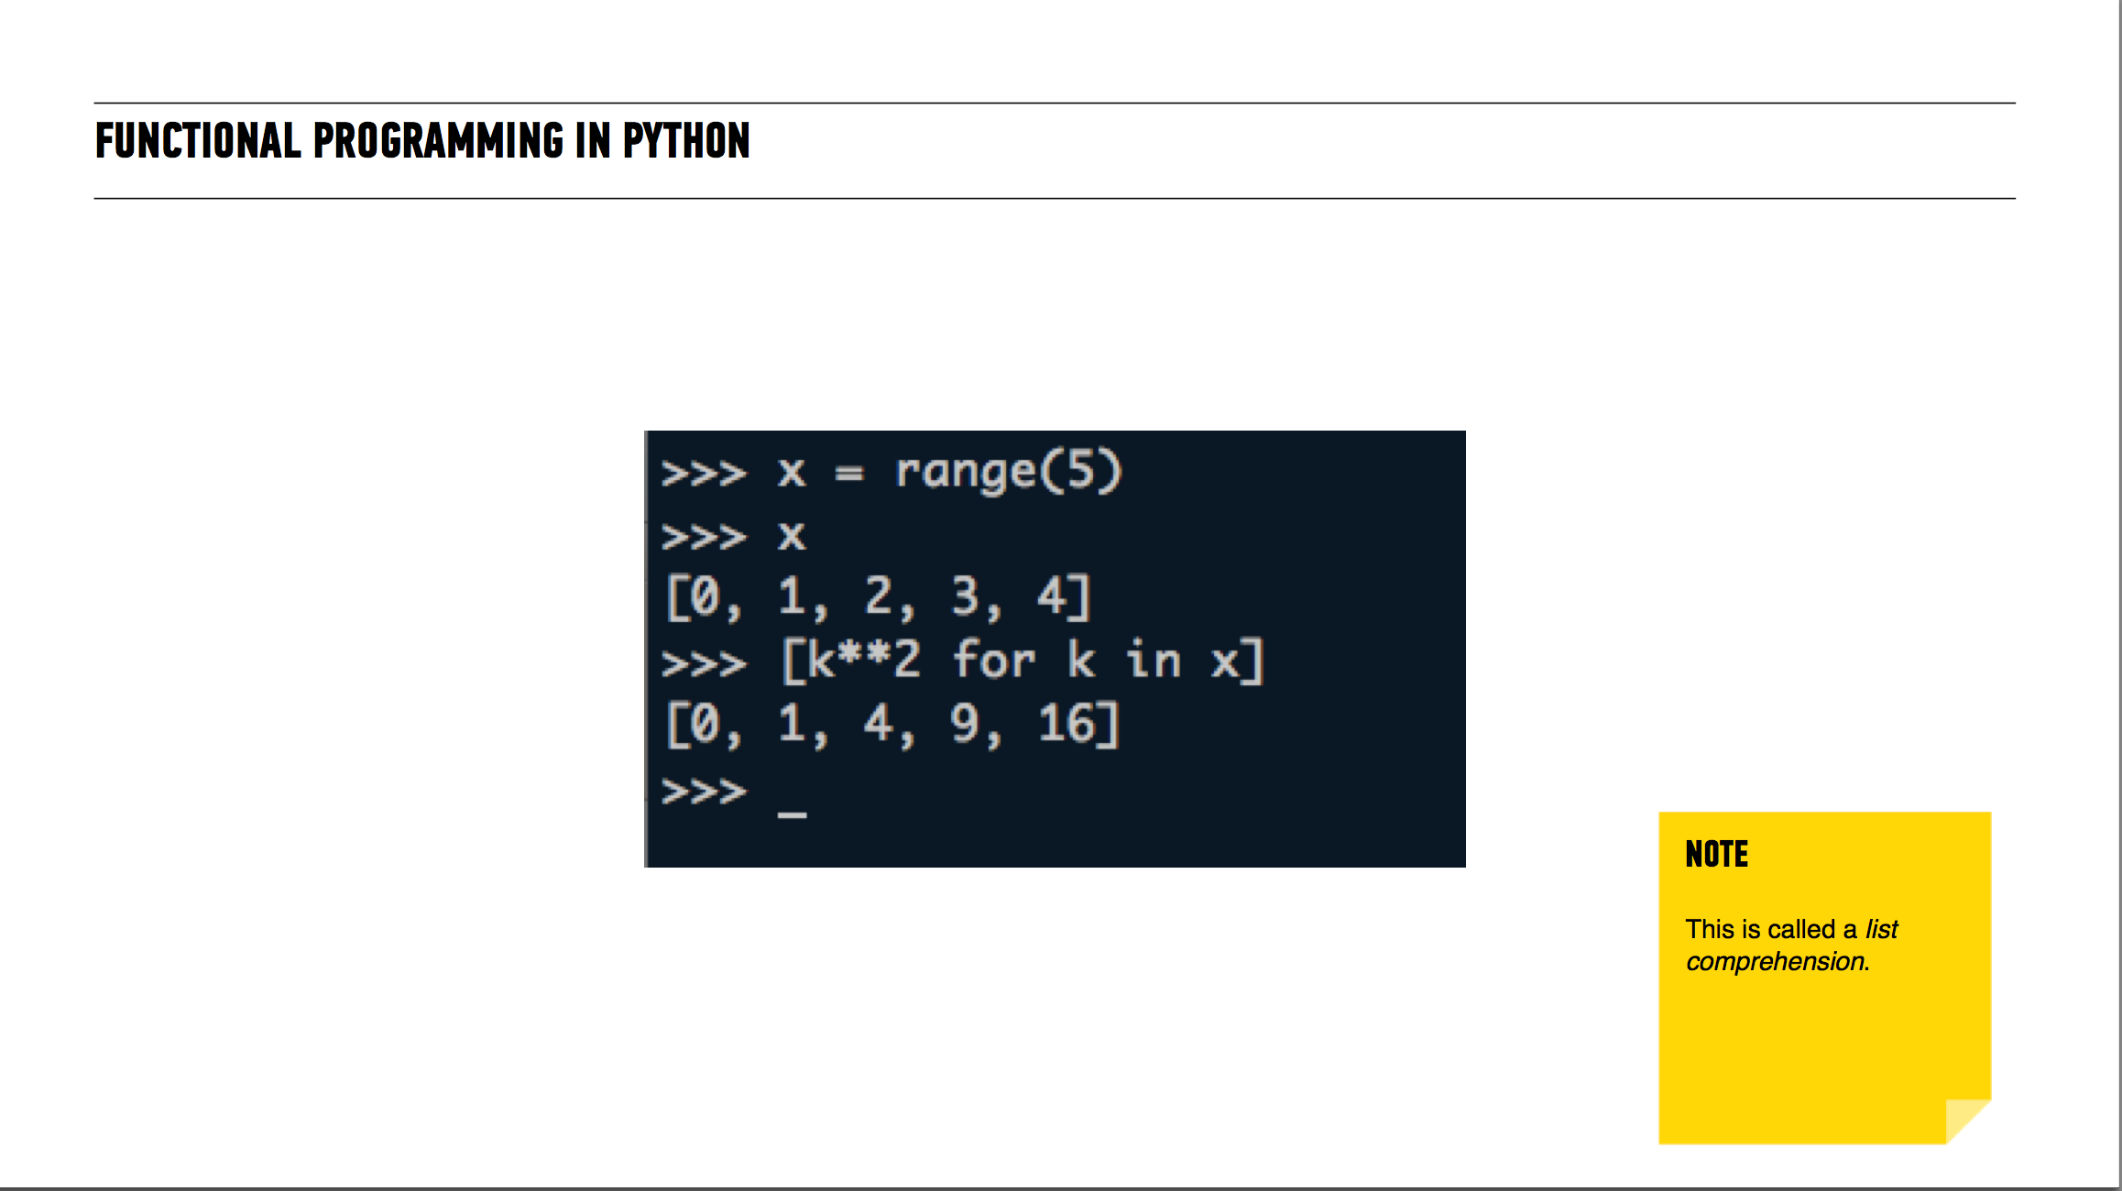

Slide 19
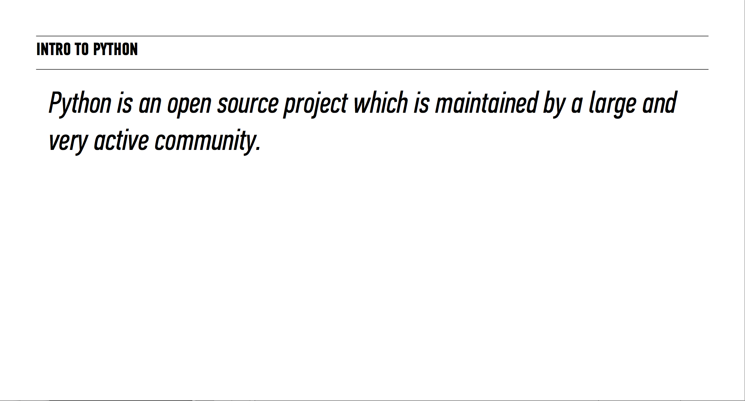

Slide 20
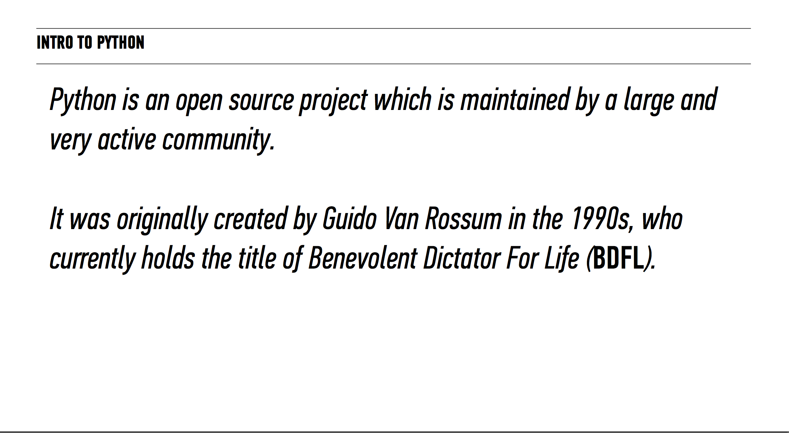

Slide 21
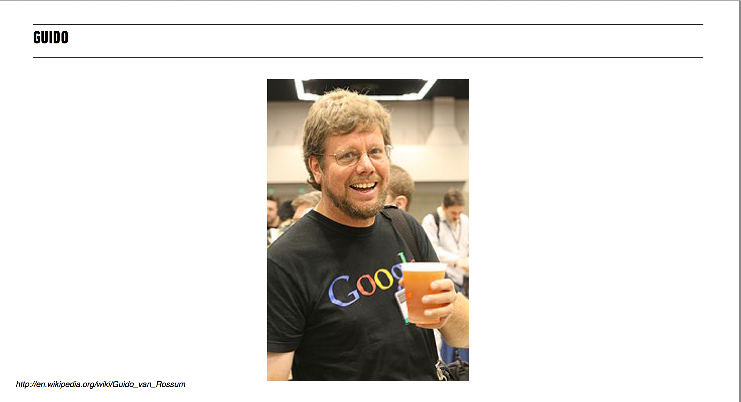

Slide 22
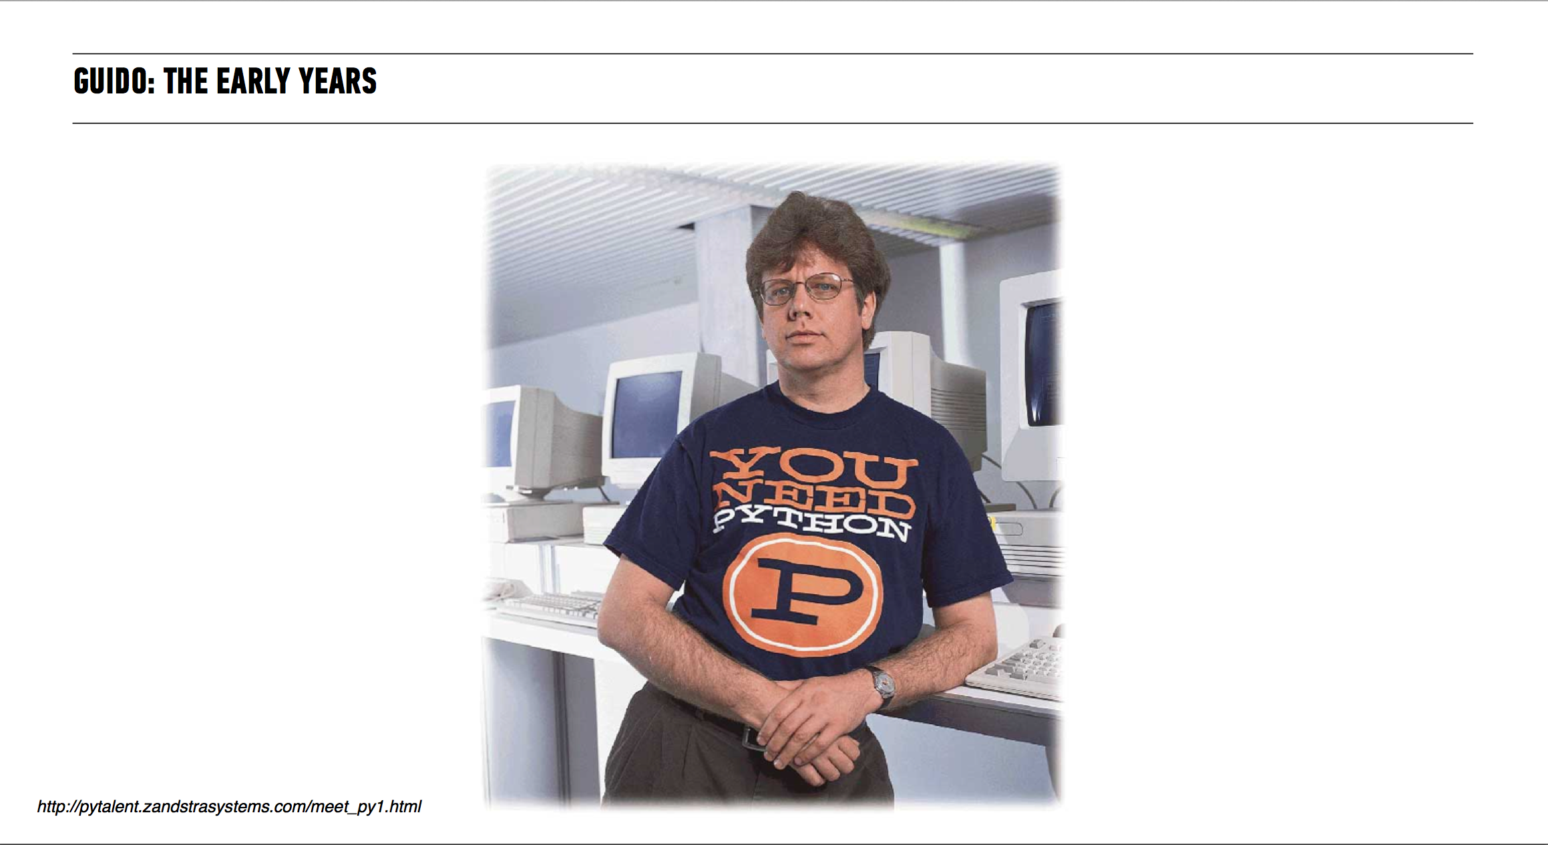

Slide 23
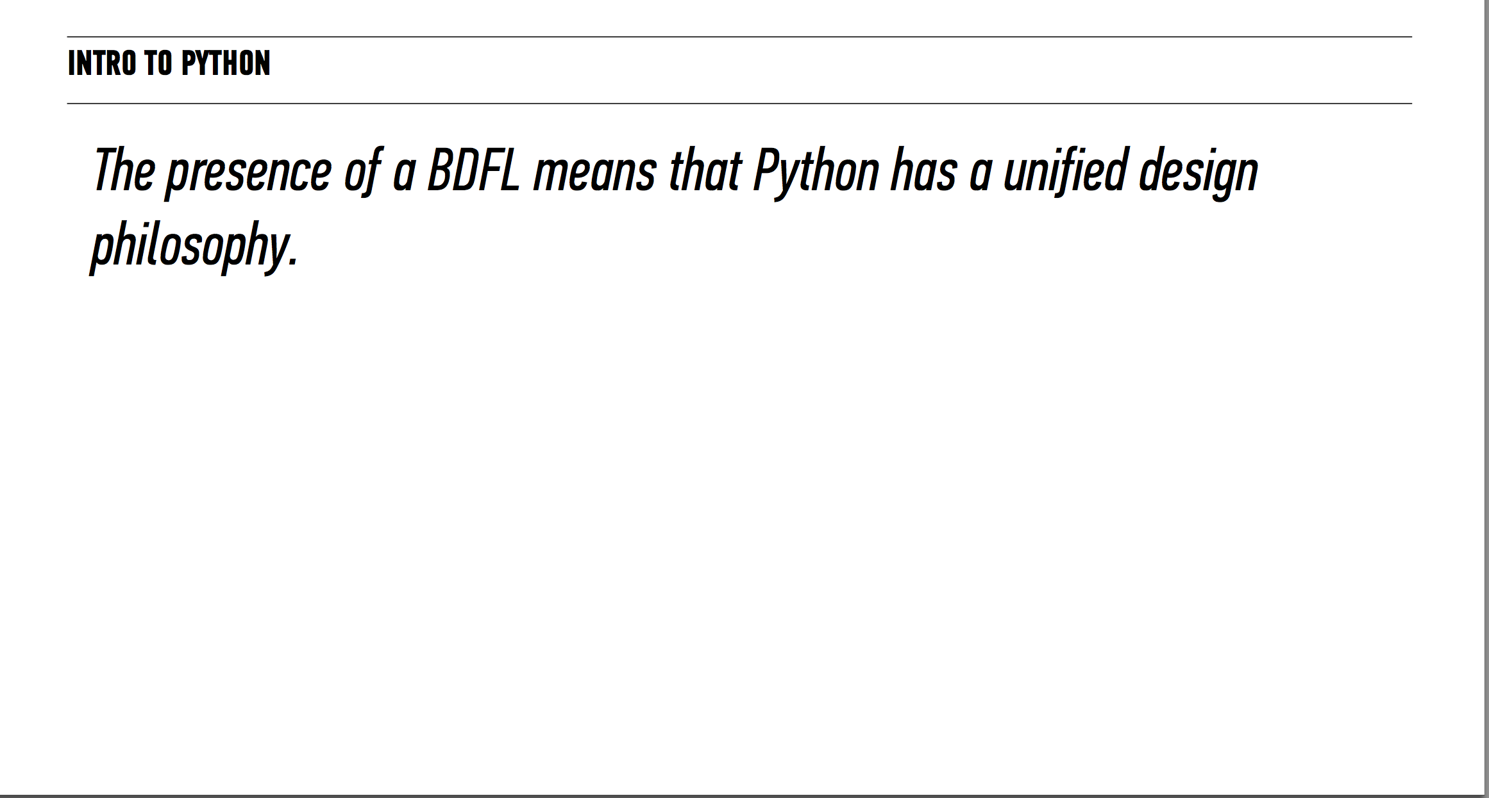

Slide 24
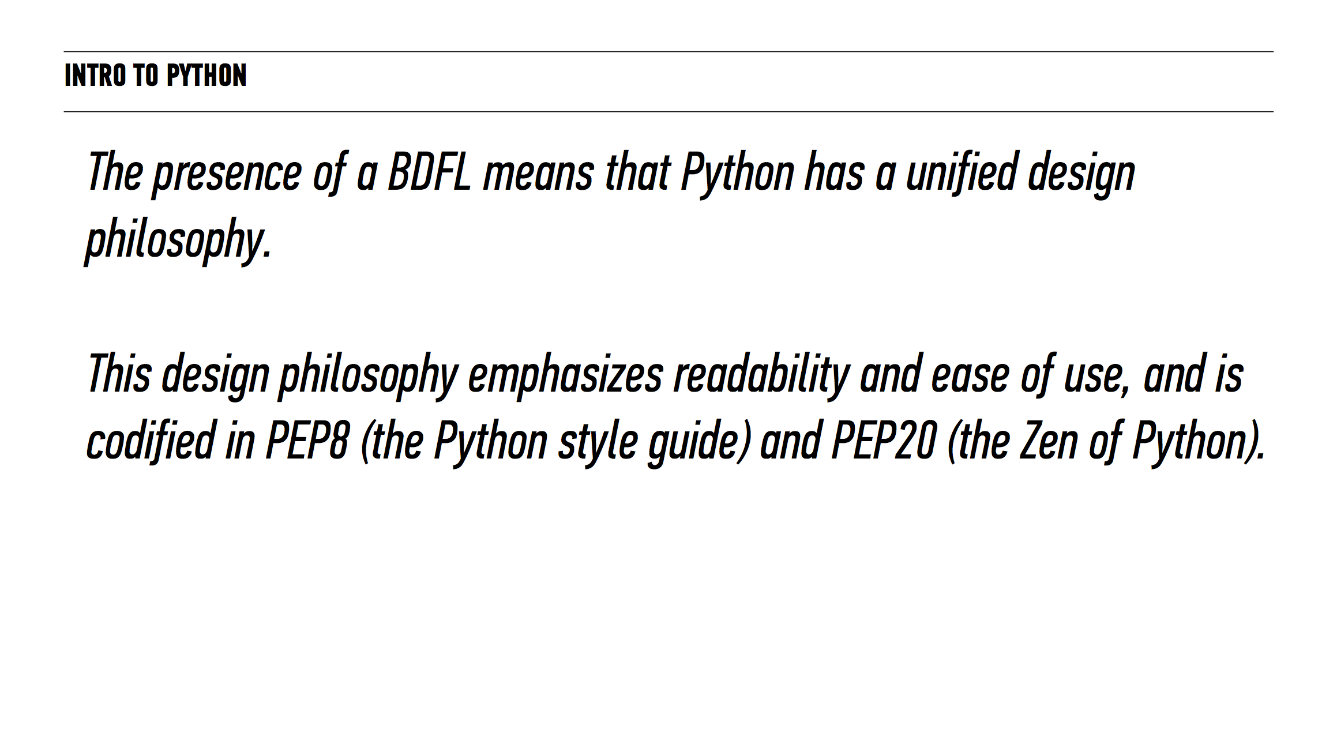

Slide 25
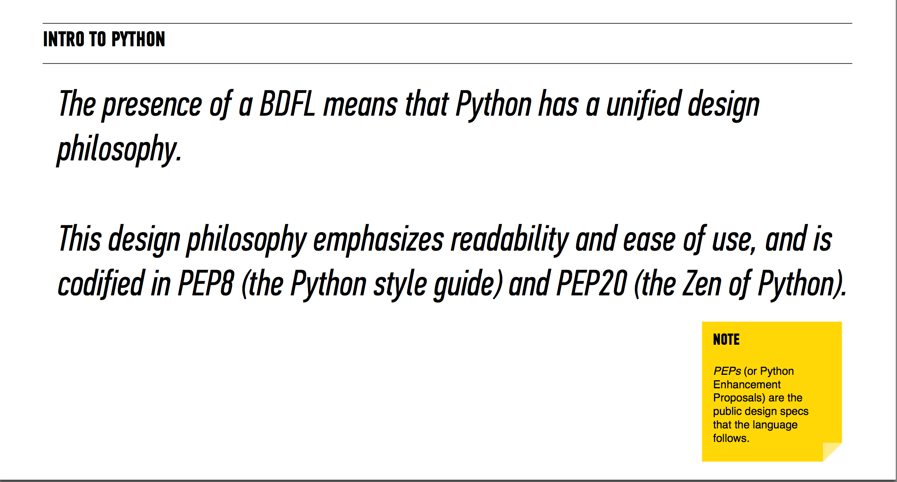

Slide 26
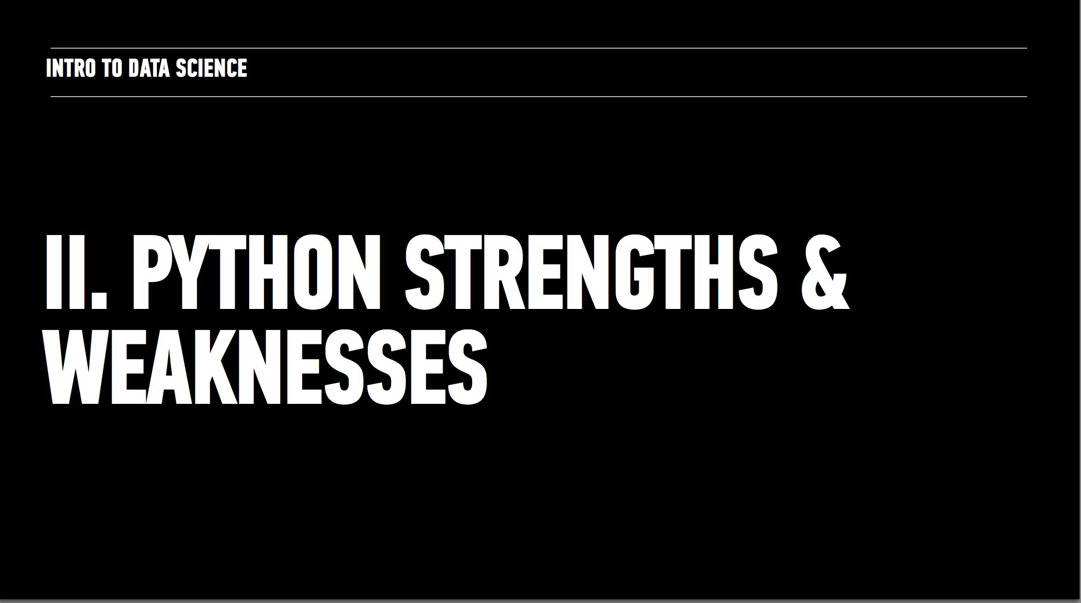

Slide 27
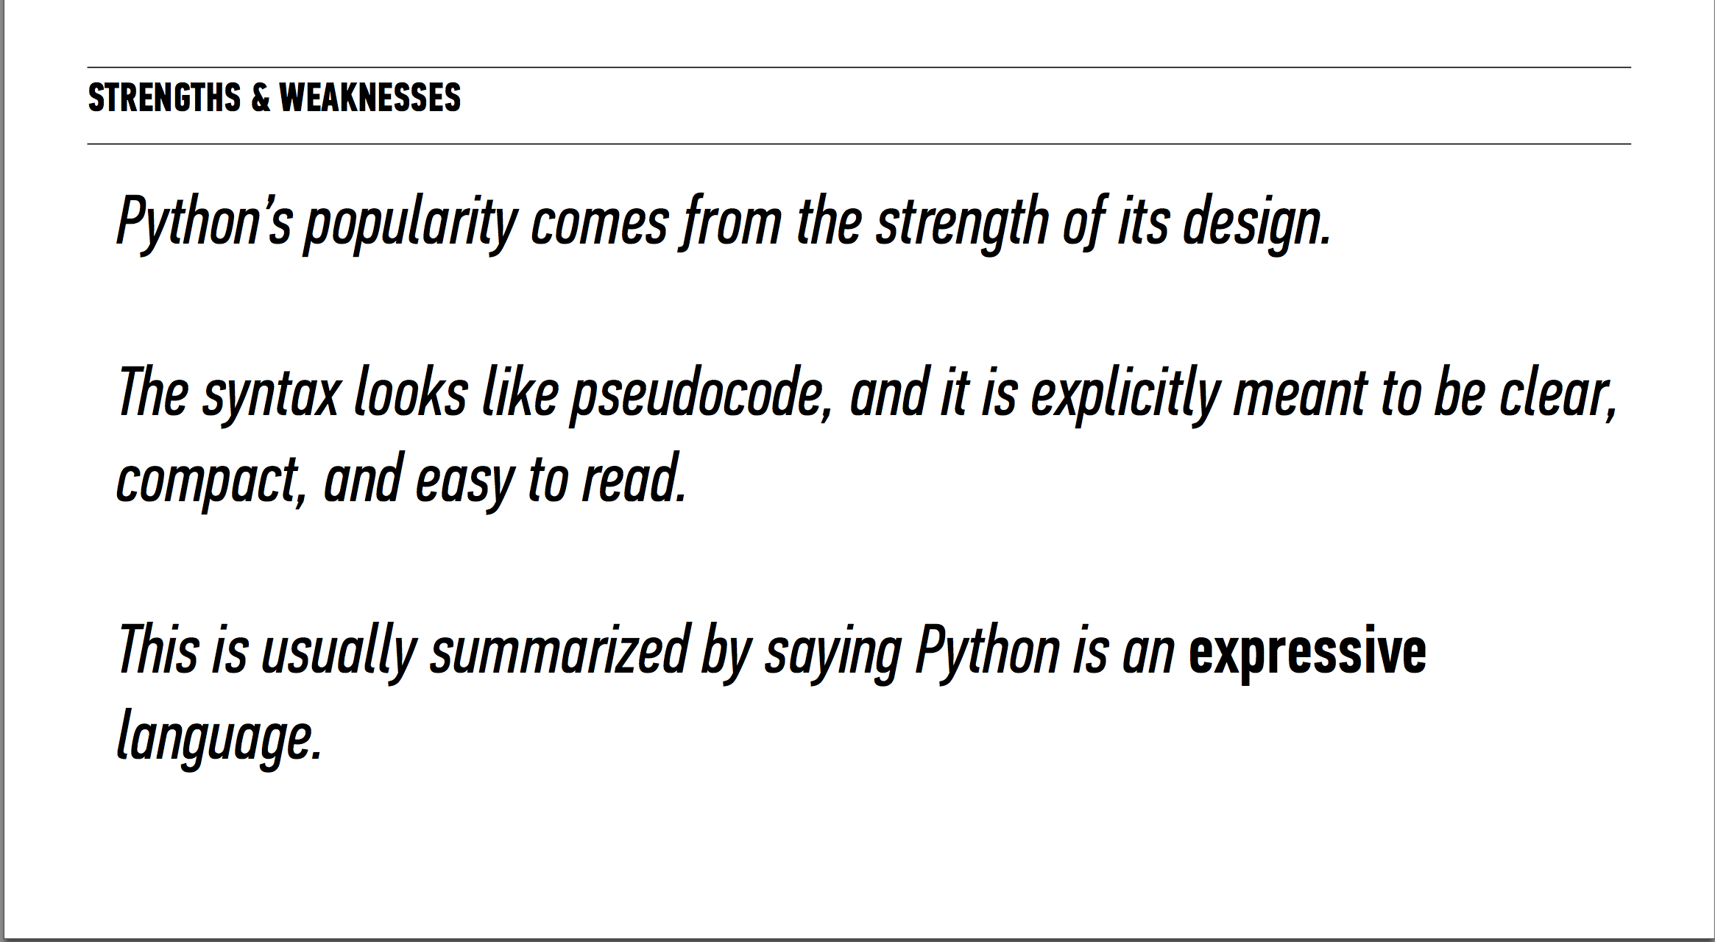

Slide 28
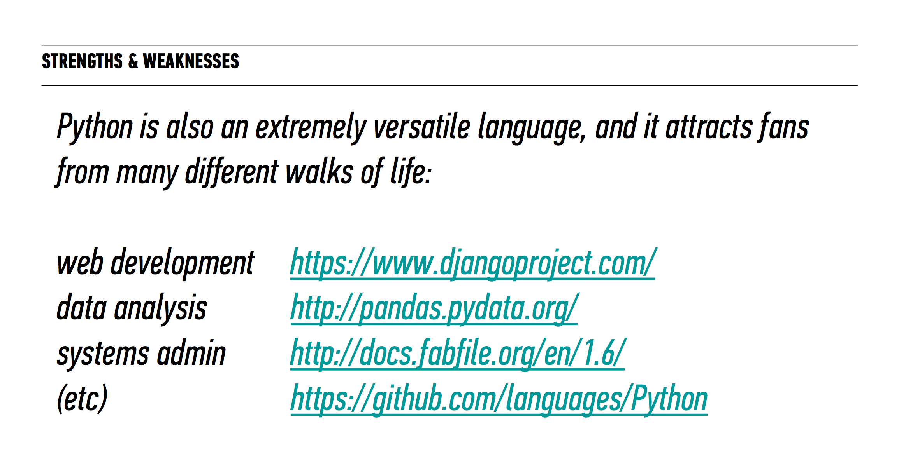

Slide 29
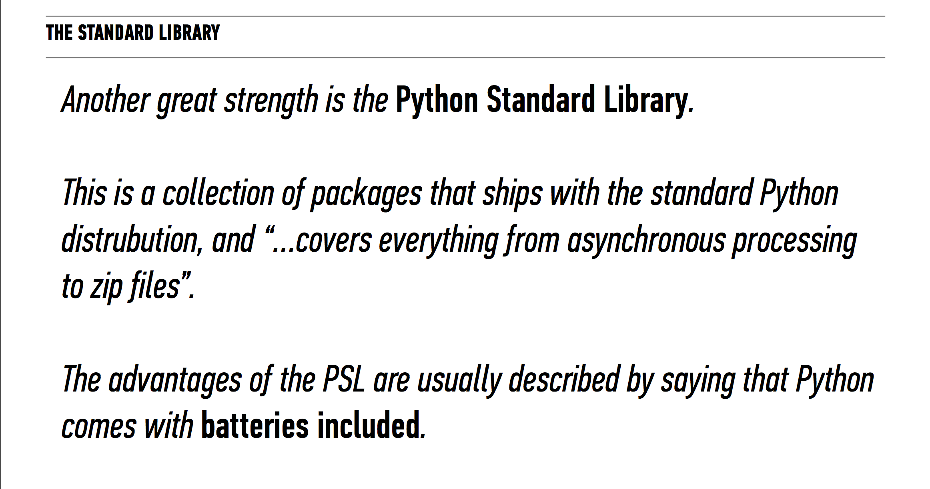

Slide 30
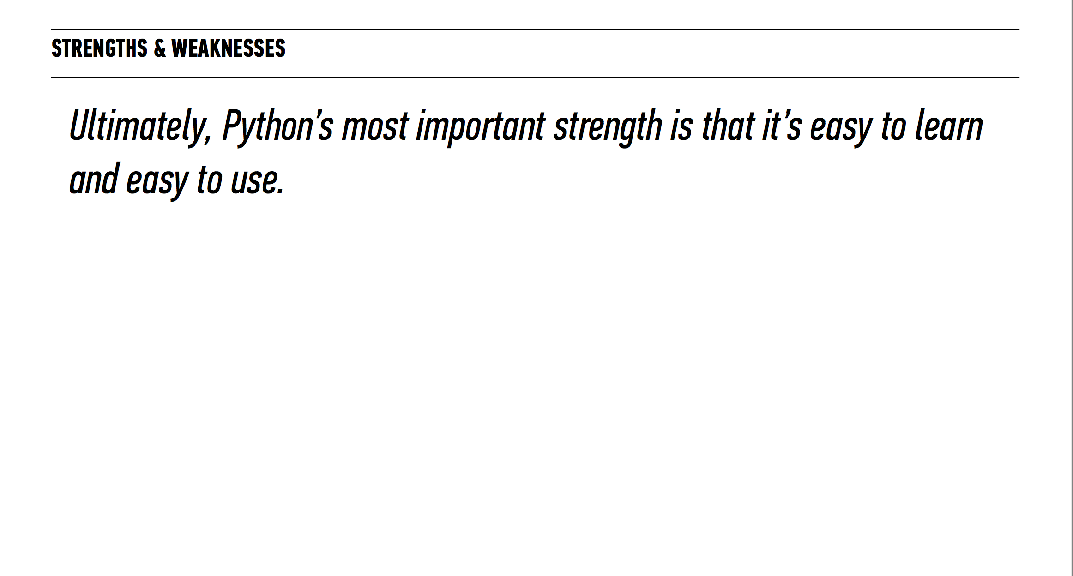

Slide 31
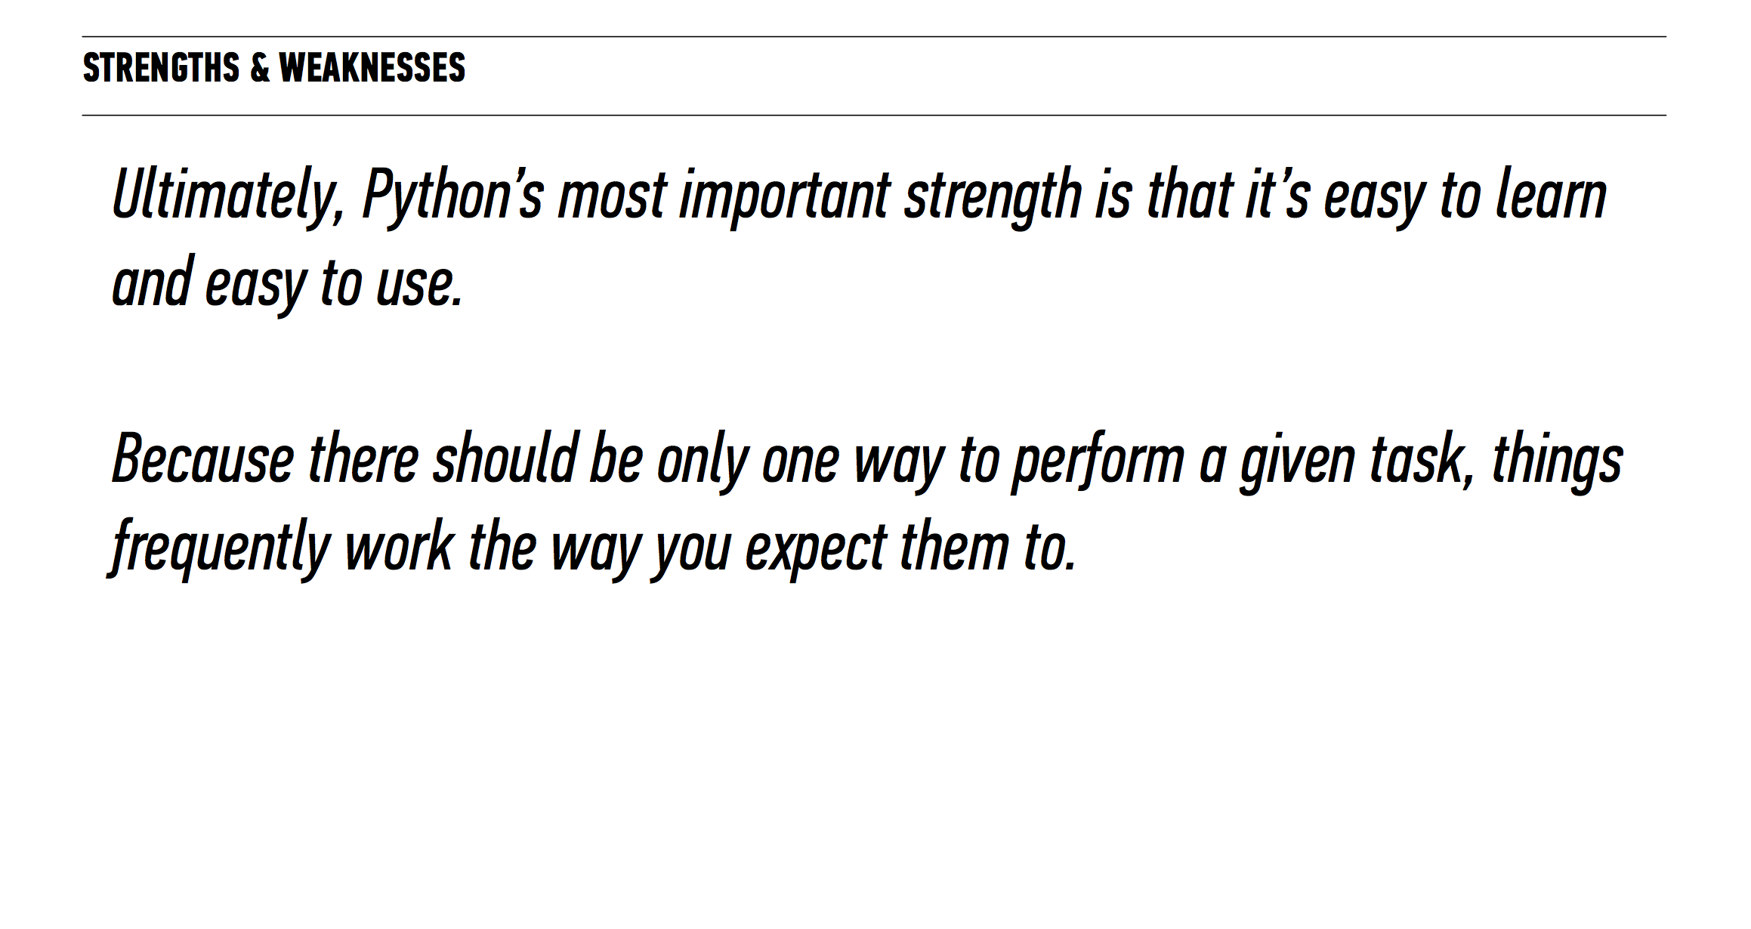

Slide 32
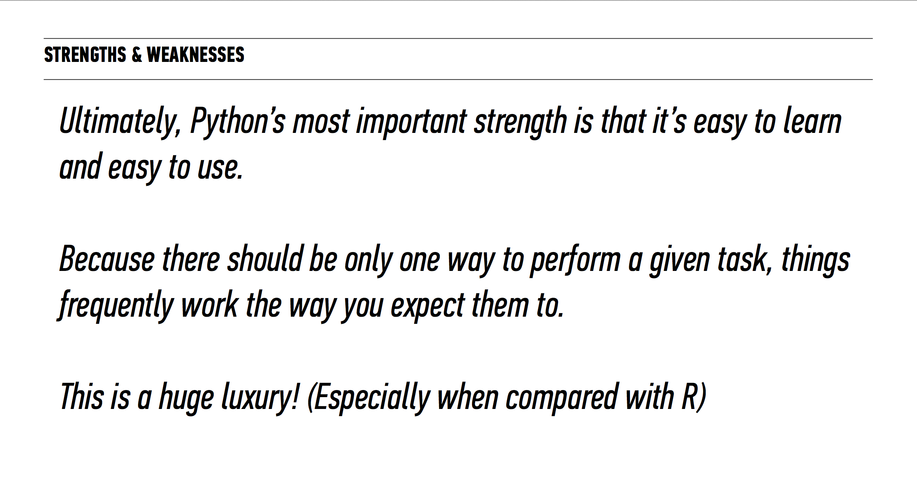

Slide 33
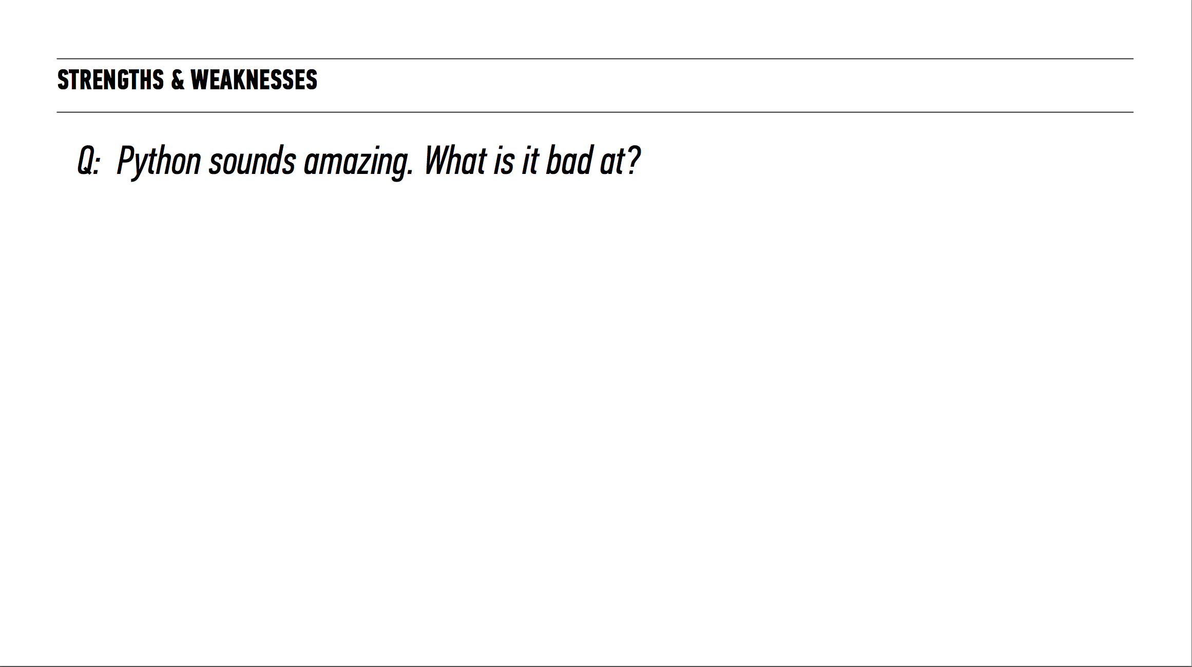

Slide 34
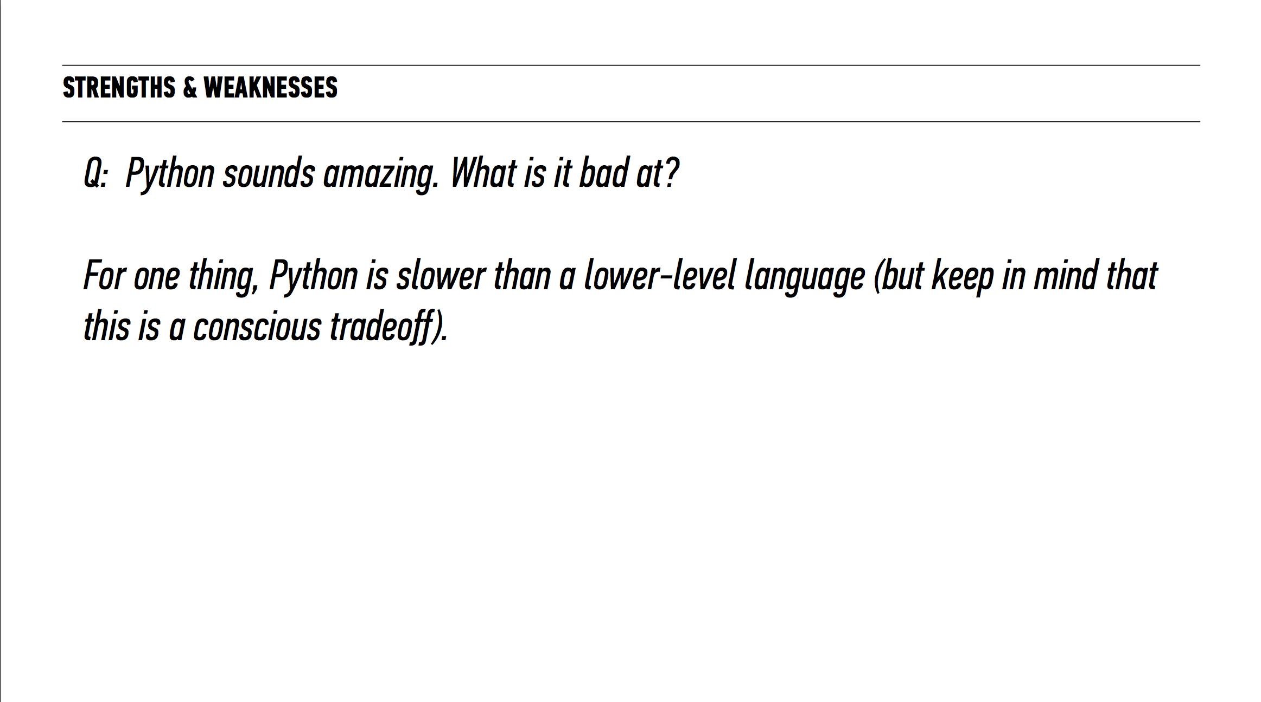

Slide 35
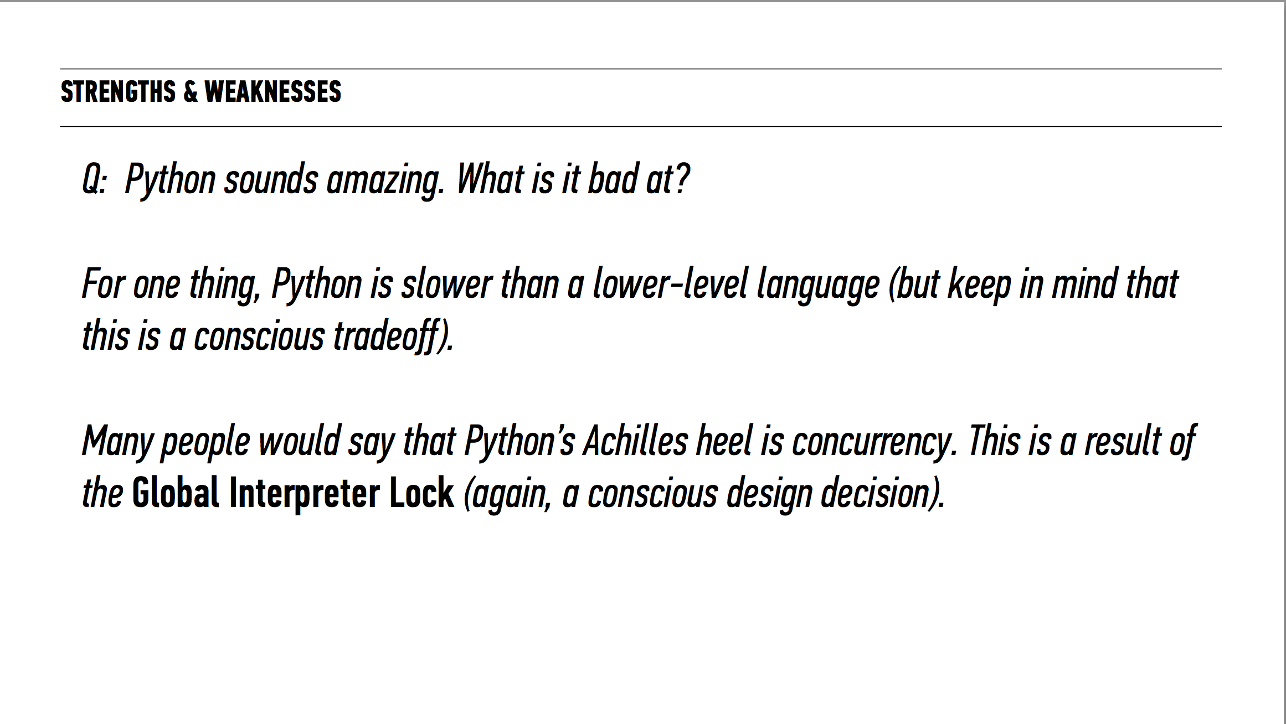

Slide 36
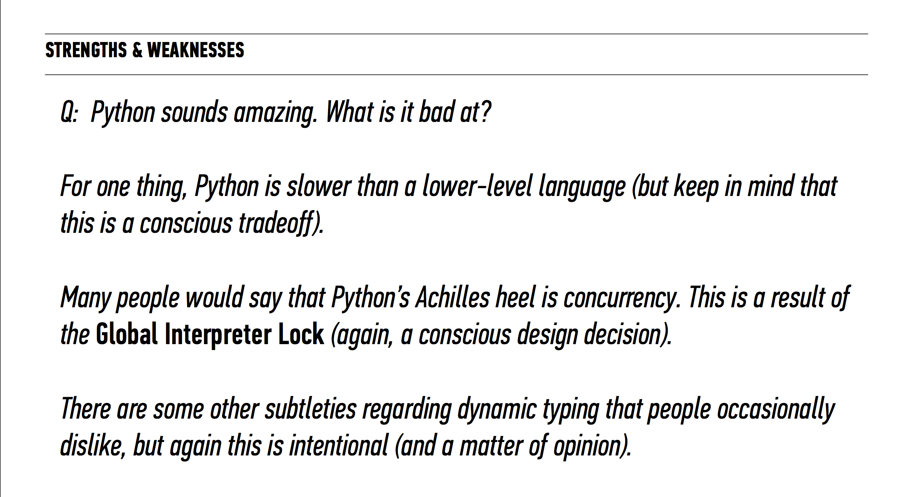

Slide 37
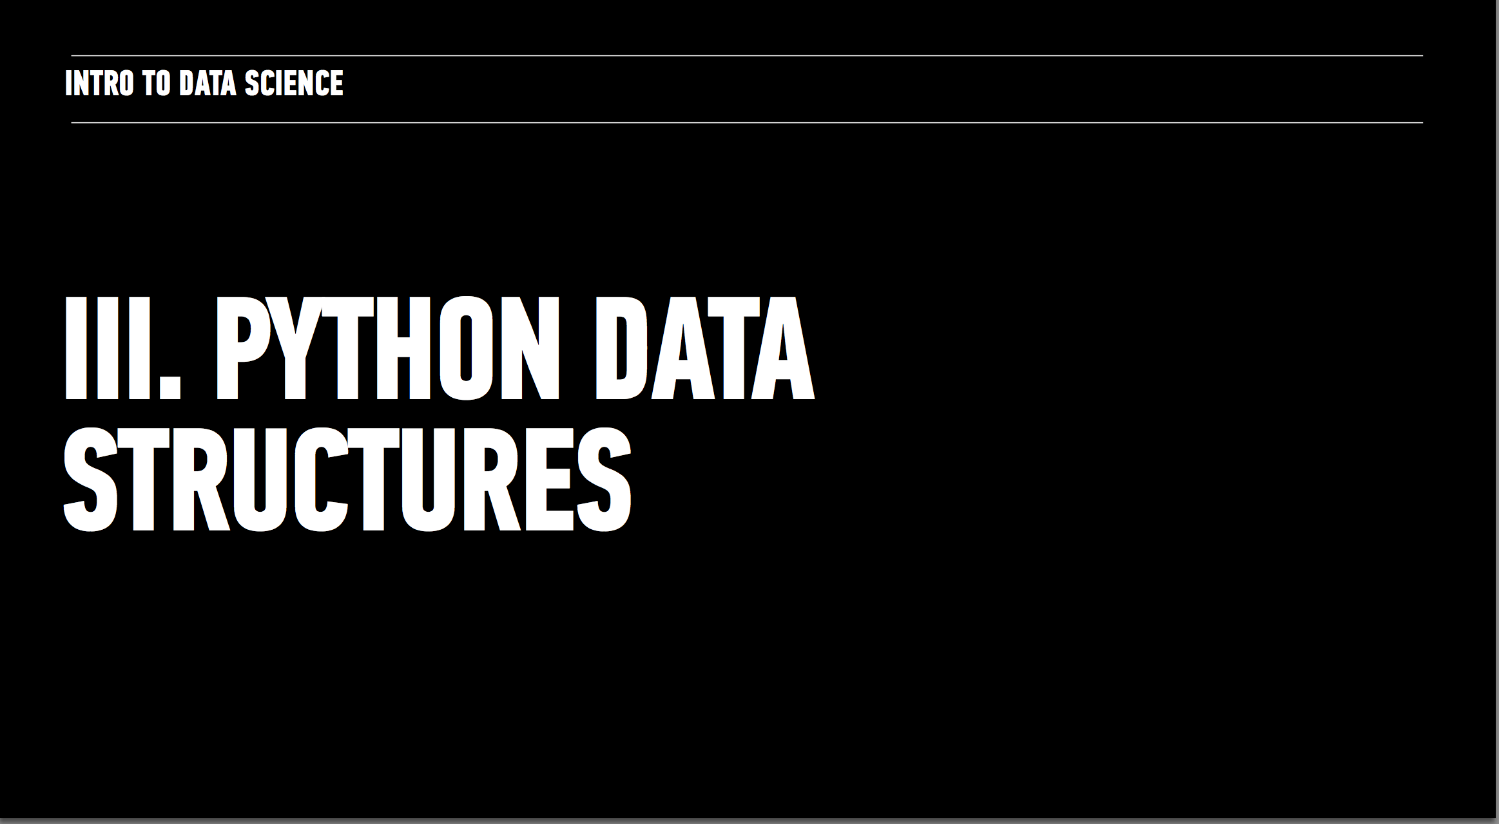

Slide 38
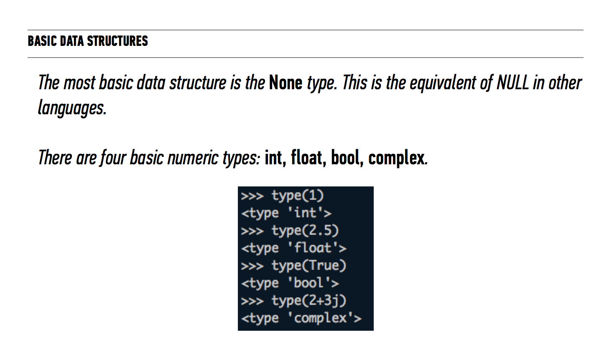

Slide 39
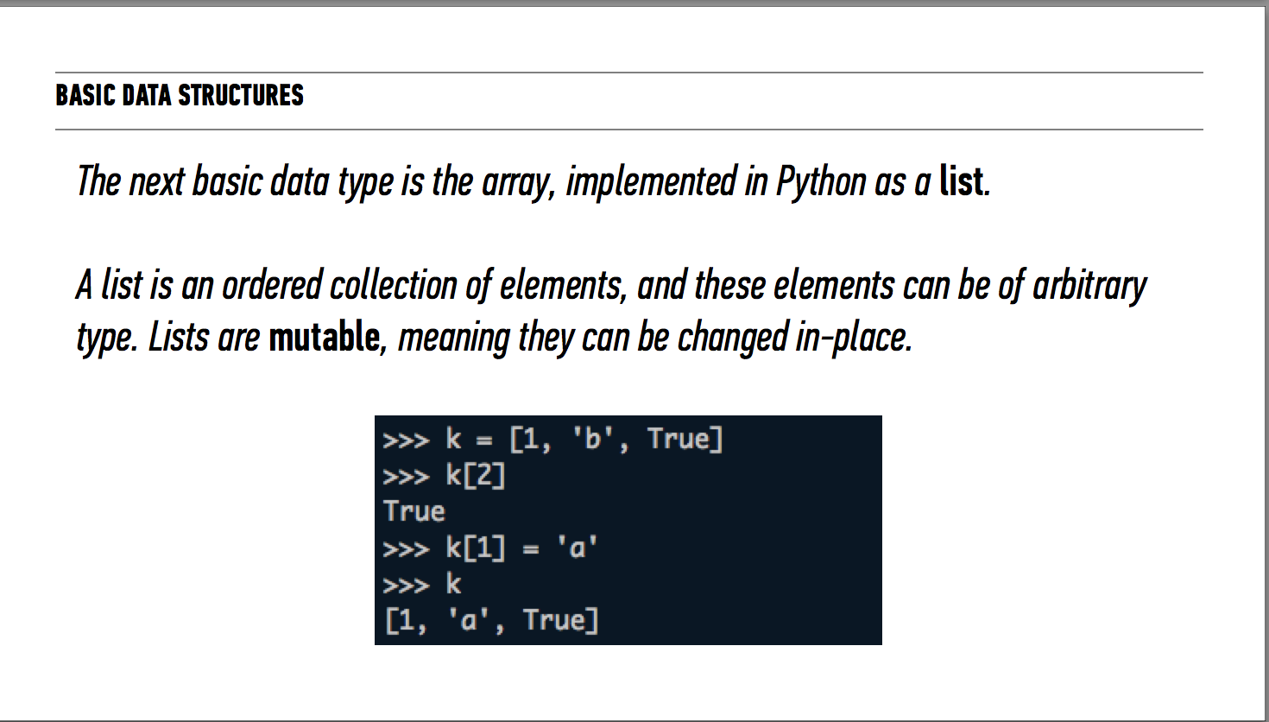

Slide 40
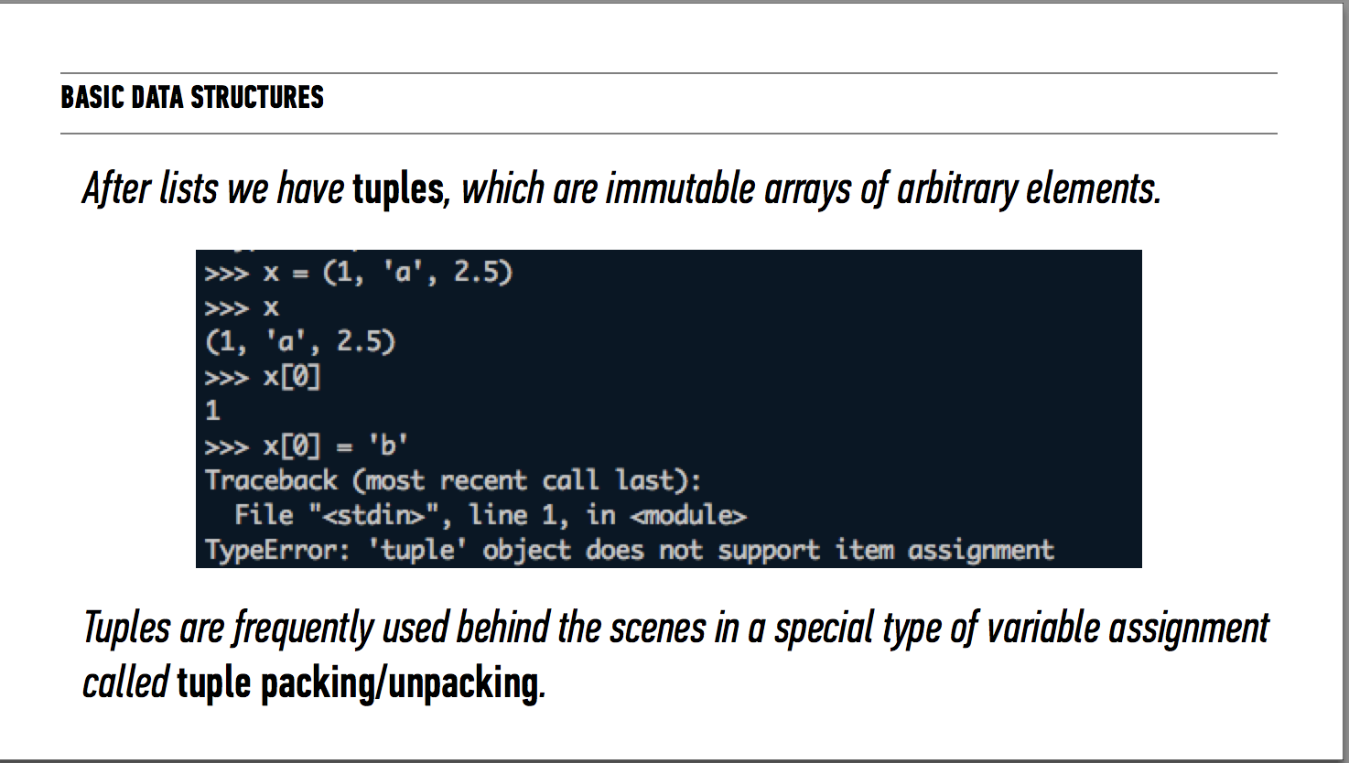

Slide 41
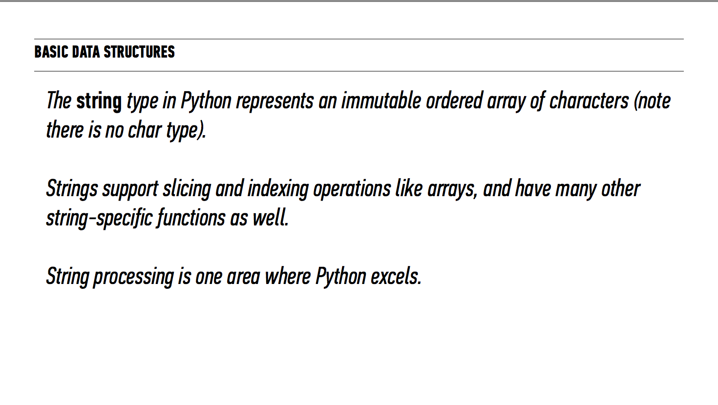

Slide 42
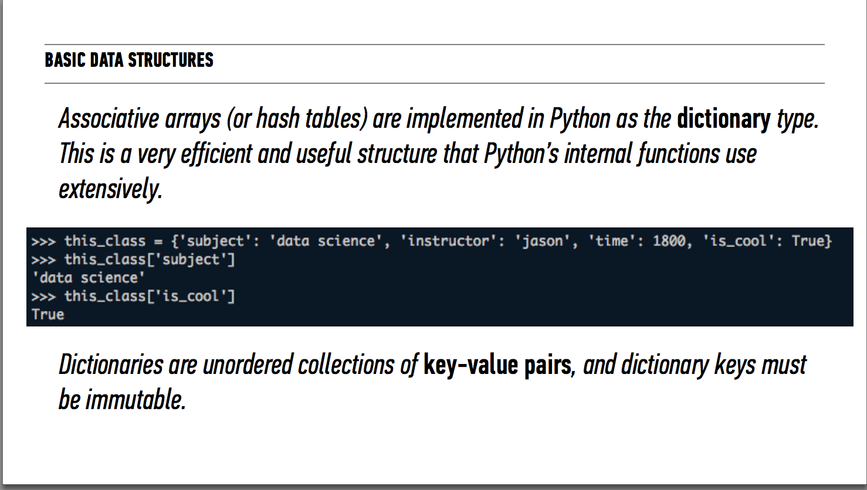

Slide 43
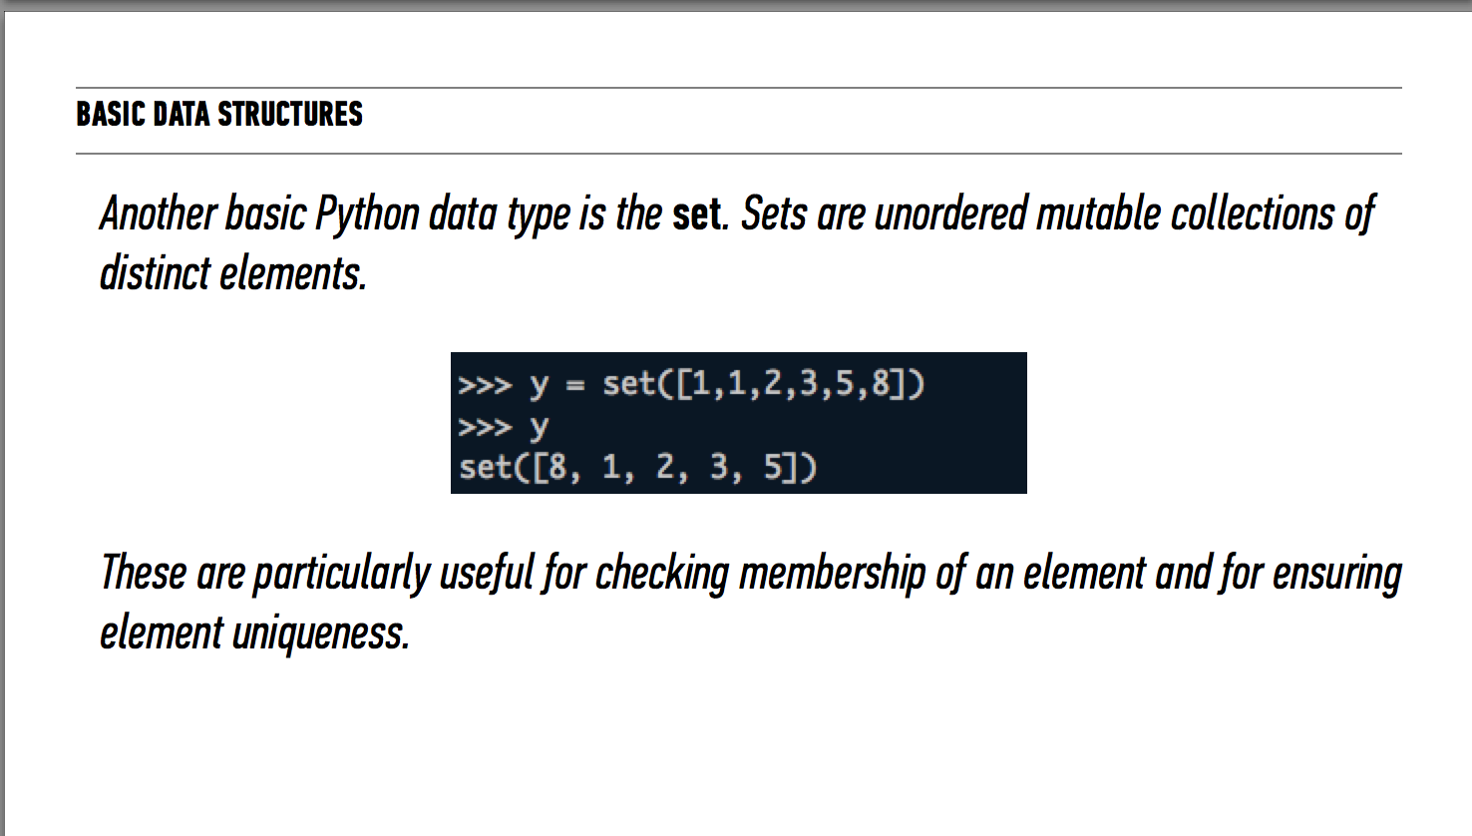

Slide 44
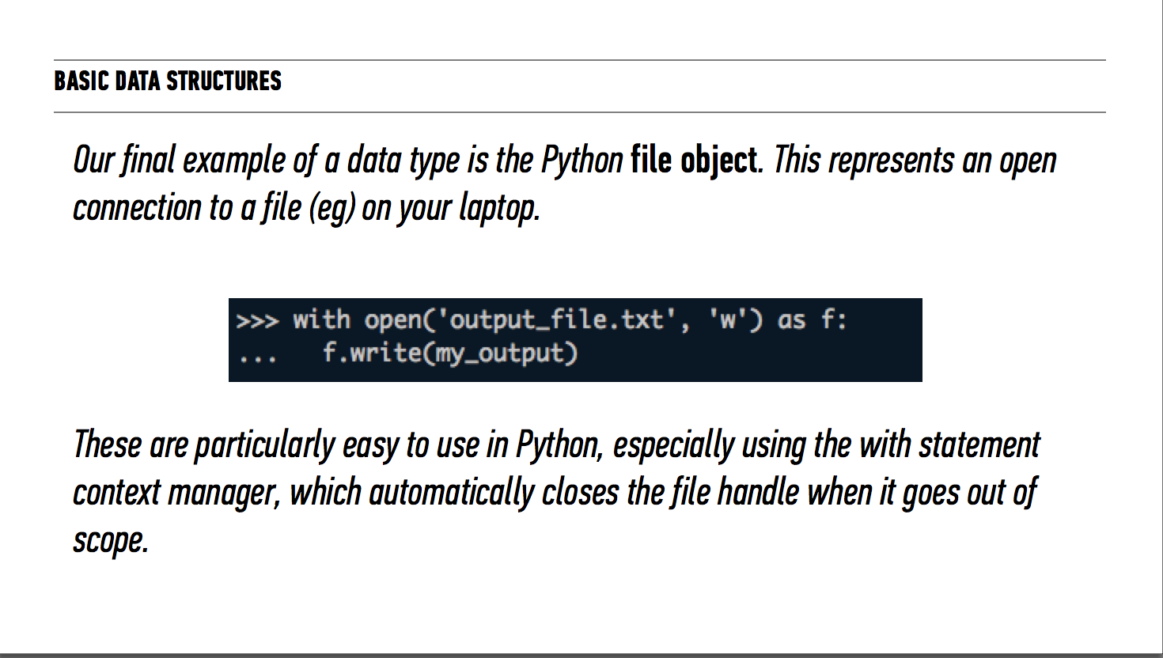

Slide 45
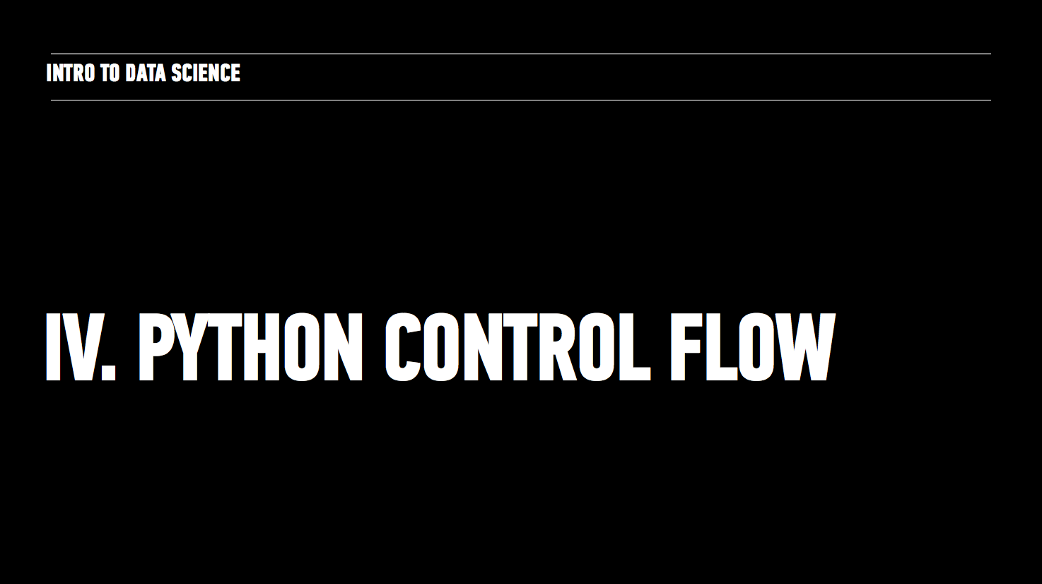

Slide 46
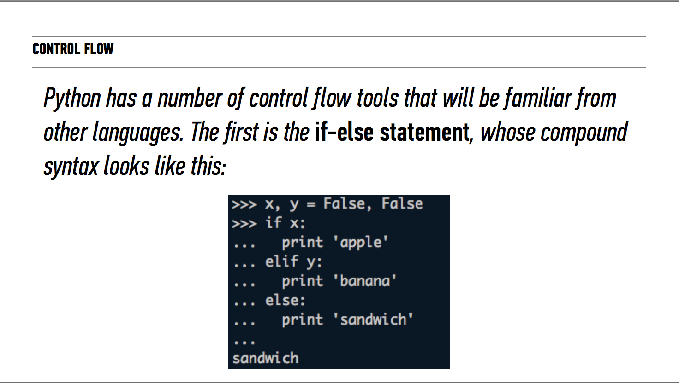

Slide 47
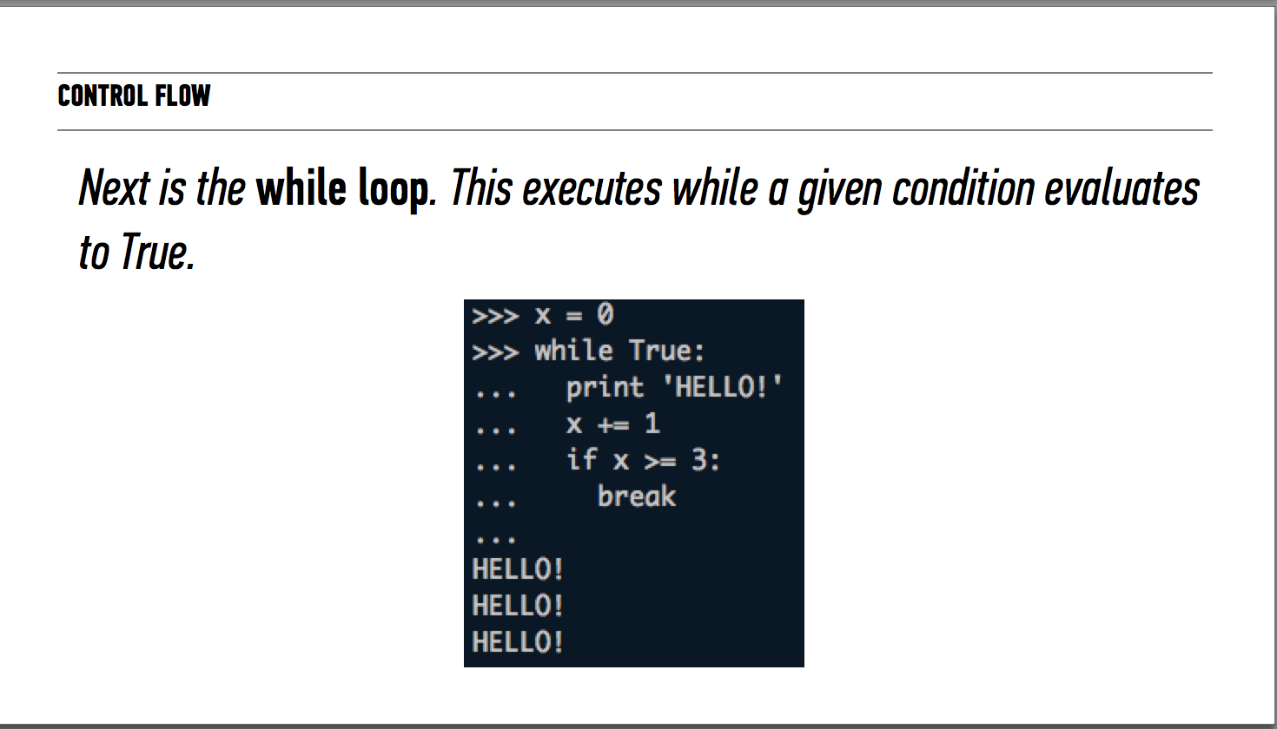

Slide 48
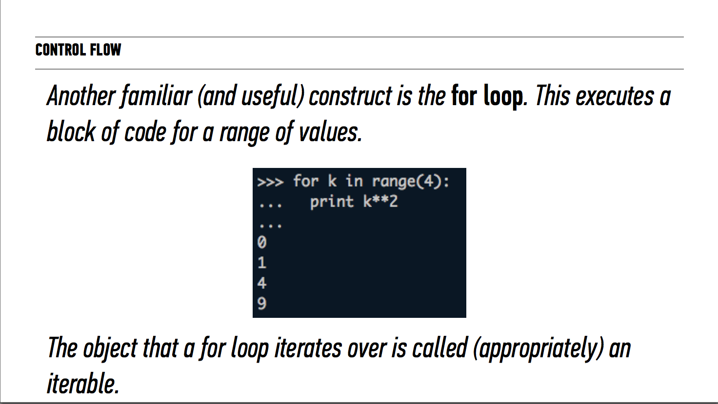

Slide 49
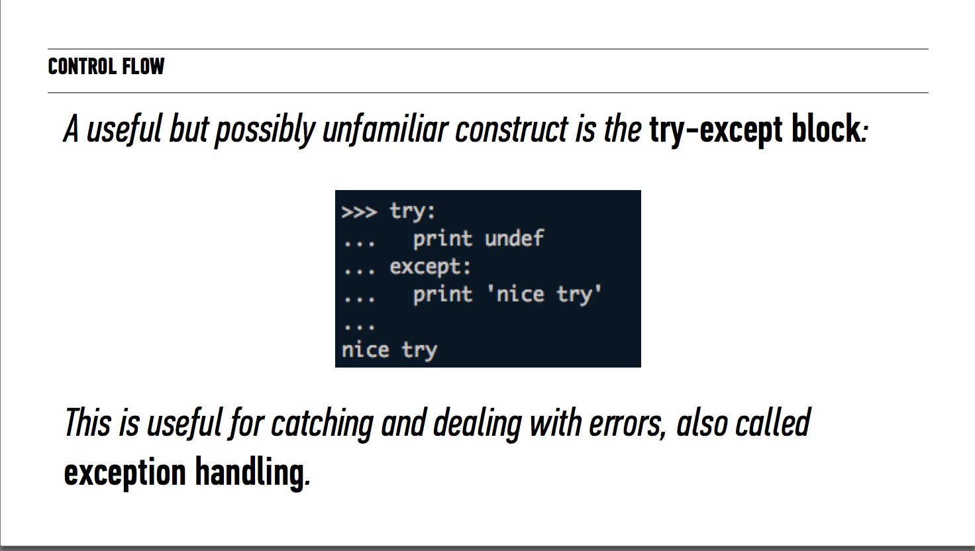

Slide 50
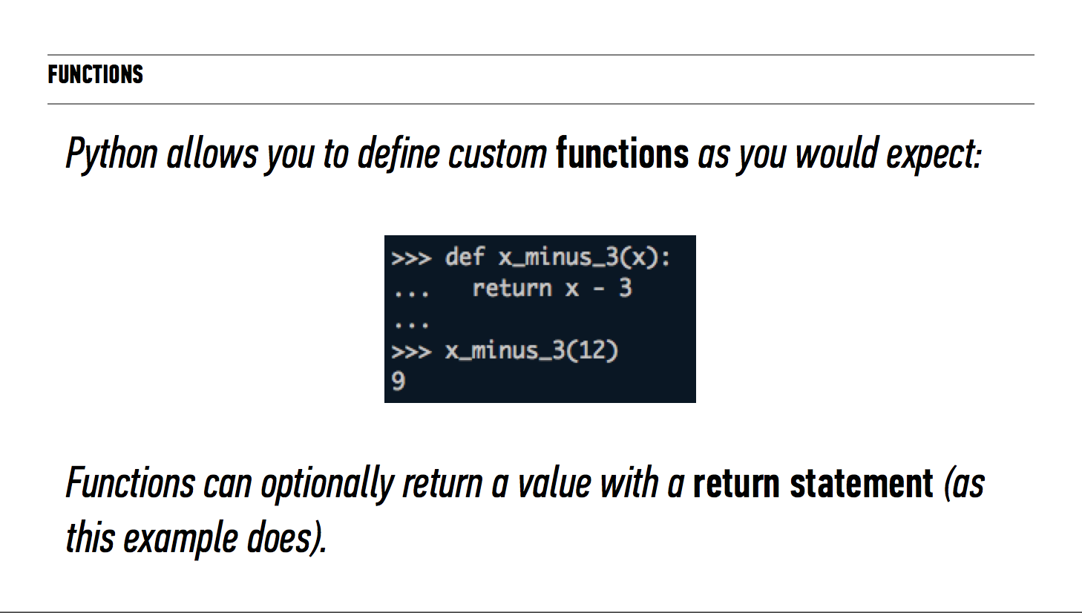

Slide 51
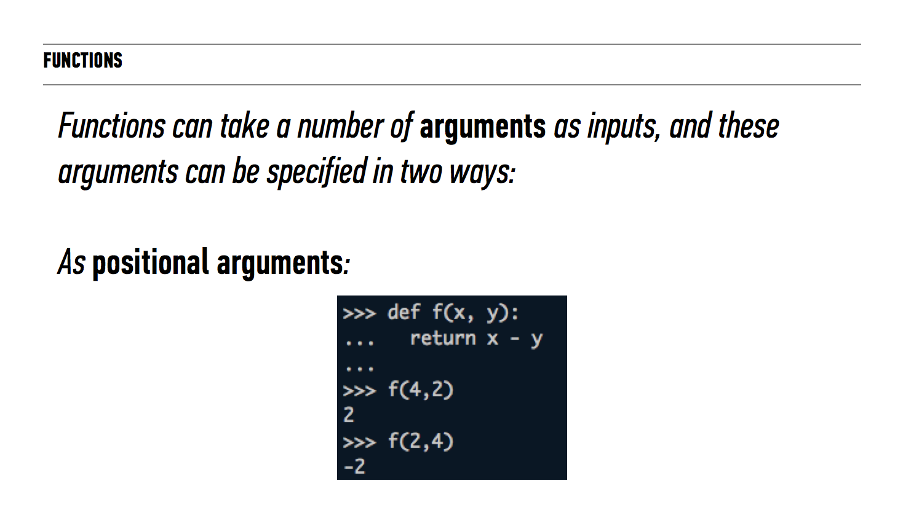

Slide 52
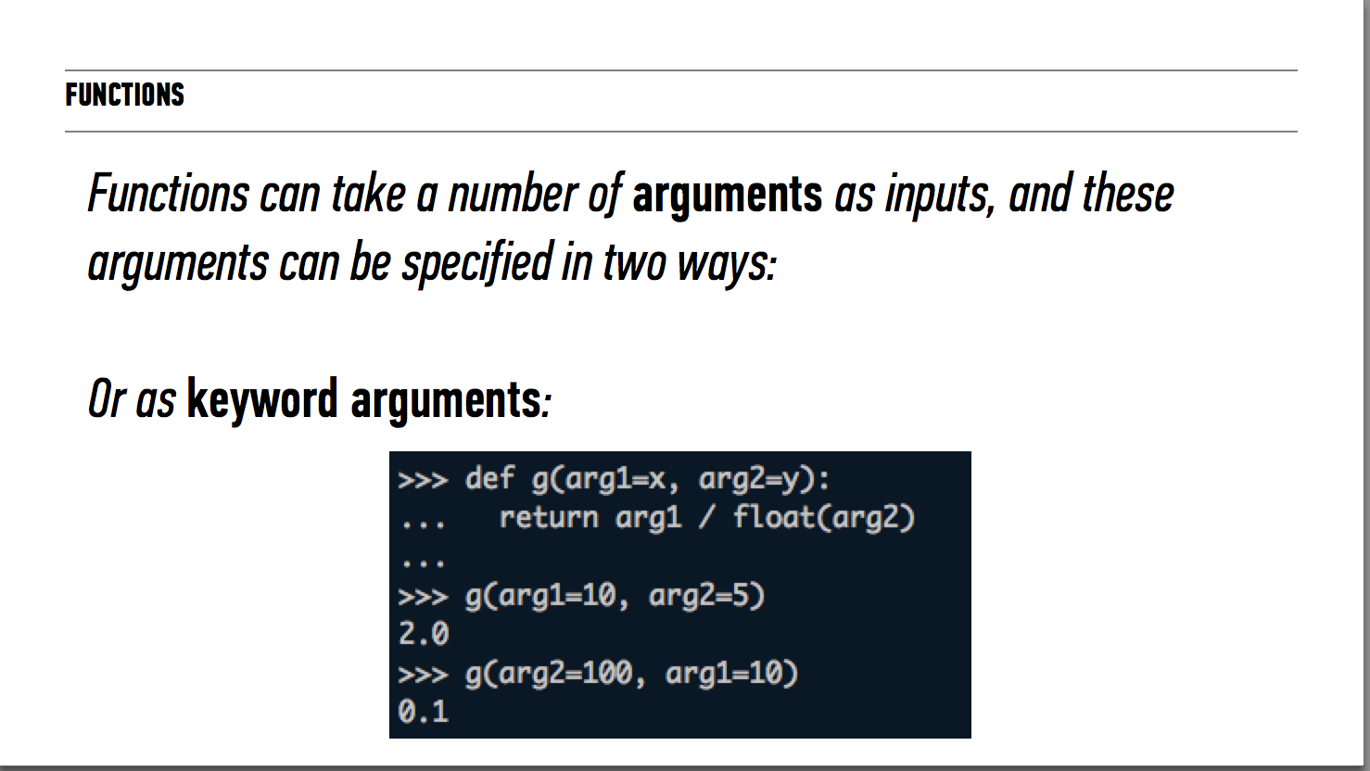

Slide 53
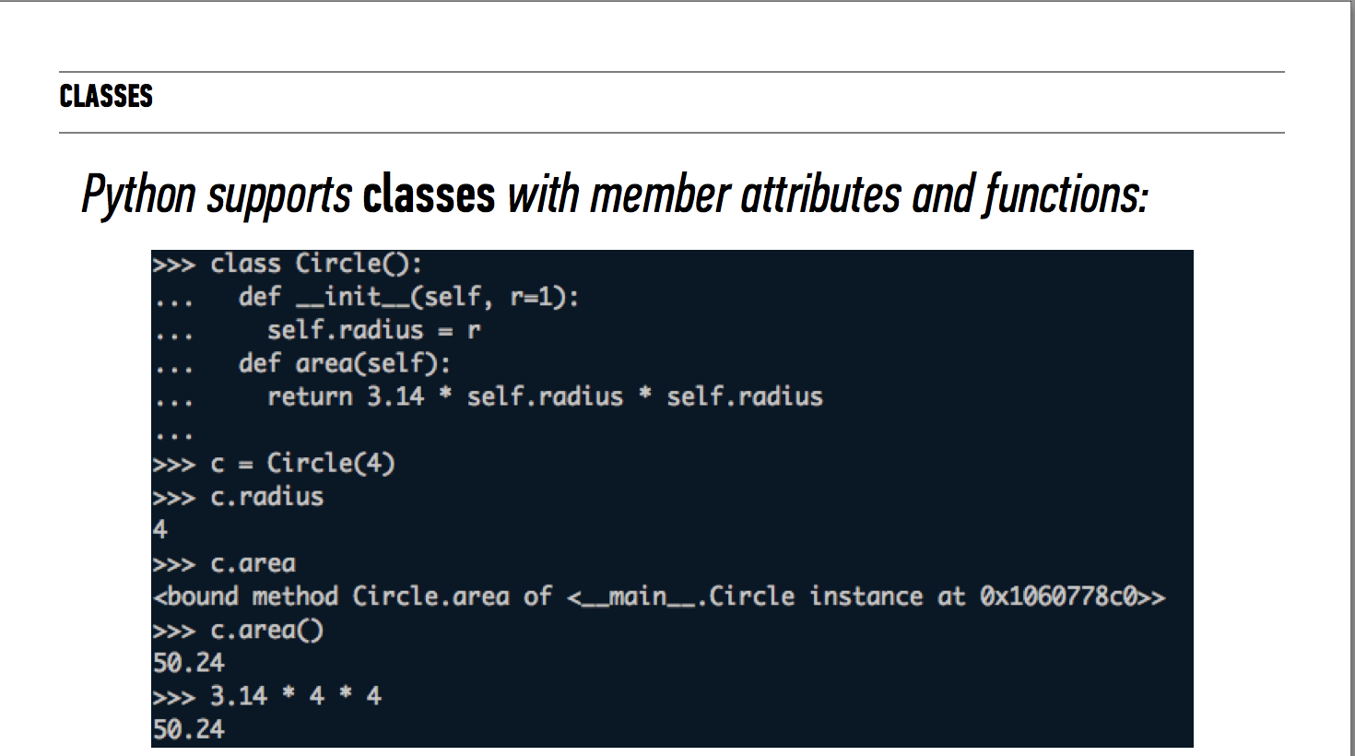

Slide 54
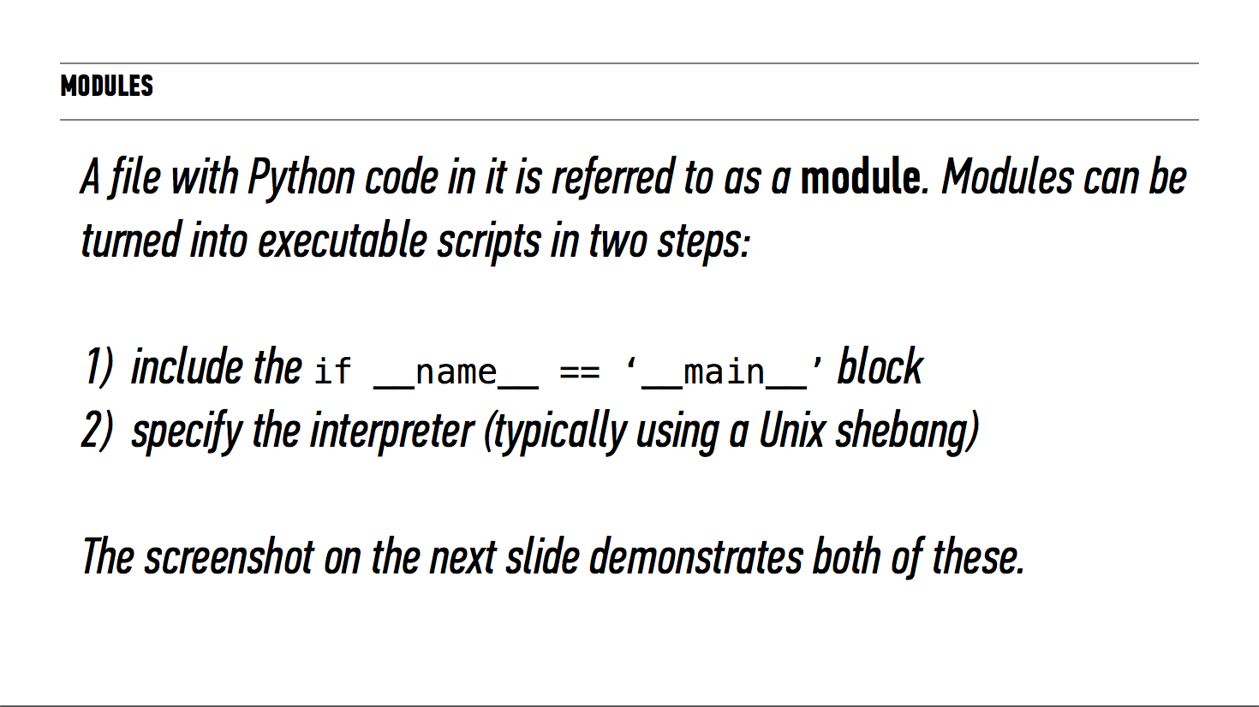

Slide 55


Slide 56


Slide 57


Slide 58


Slide 59


Slide 60


Slide 61


Slide 62


Slide 63


Slide 64


Slide 65


Slide 66


Slide 67


Slide 68


Slide 69


Slide 70
Exit Ticket

Slide 71
TODAY
Deep dive into python and programming tools
Described the programming landscape
Created our first iPython Notebook from scratch became familiar with how to work with data in python with the pandas library
Preview of plotting and time series
Notes:
Feedback is a part of the GA experience. It is used to tweak the DAT experience from instance to instance. Helps instructors know what’s working well and what can be improved. Your producer, Daniel also communicates feedback to the appropriate teams that work behind the scenes at GA.

Slide 72
UP NEXT
HW1 due by 5pm on Tuesday September 1
Intro to Machine Learning
Descriptive data sets
KNN Alogrithm
Notes:
Feedback is a part of the GA experience. It is used to tweak the DAT experience from instance to instance. Helps instructors know what’s working well and what can be improved. Your producer, Daniel also communicates feedback to the appropriate teams that work behind the scenes at GA.

